Slide 1
AI Tools for Literature Reviews
Jason Coleman
Livia Olsen
Carol Sevin
October 14, 2024

Slide 2
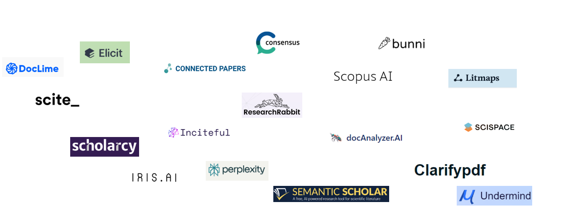
AI Tools for Document Discovery & Analysis

Slide 3
Varieties of AI-Powered Tools for Literature Reviews
Semantic Search and Retrieval Augmented Generation
User provides natural language prompt.
Tool searches corpus of papers.
Results based on semantic relevance are presented as tables and/or answers.
Notes:
The second type are tools that use semantic search to enable natural language queries and retrieval augmented generation to provide answers and summaries via a Large-Language model.

Slide 4
Varieties of AI-Powered Tools for Literature Reviews
Similarity calculators (aka literature mappers)
User identifies one or more seed papers.
Tool analyses networks of citations and/or authorship.
Results based on similarity are presented as maps
or lists.
Notes:
There are scores of tools that use AI to augment the discovery of academic research publications and/or make it easier to learn from the results. After playing with dozens of them, we realized that they fall into three main types. The first and oldest type are tools that help you find papers that are related to a set you have already found. We will work with Research Rabbit in a few minutes.

Slide 5
Varieties of AI-Powered Tools for Literature Reviews
Document Summarizers and Interrogators
User uploads documents.
Tool can answer questions about a specific document
or a set of documents.
Some tools create reports with analysis and/or
summary.
Notes:
The third type are tools that analyze documents you upload. You can chat with your documents. Some provide automatically generated analyses.

Slide 6
Benefits of using semantic search tools with retrieval augmented generation
Reduces need to know search syntax.
Reduces need to generate alternate keywords.
Enables rapid extraction of answers to specific questions
Expedites screening via customized summaries.
Some allow you to query uploaded documents.
Facilitate rapid discovery of scholarly vocabulary.
Notes:
These tools are not far superior to our traditional tools - at least not yet. But they do offer a different experience that can augment that provided by databases like ProQuest Central, JSTOR, and Web of Science.
These tools can help you find papers that are relevant to your research questions. Unfortunately, they can and do make things up - although they are rapidly improving in that regard.

Slide 7
Disadvantages of using semantic search tools with retrieval augmented generation
Becomes hard to leverage controlled vocabulary.
Corpus is limited - usually to open access journal articles.
Generated answers often attribute information to a citing article rather than the cited source.
They will confabulate/hallucinate/lie.
Can lead to even less close reading of the literature.
Notes:
These tools are not far superior to our traditional tools - at least not yet. But they do offer a different experience that can augment that provided by databases like ProQuest Central, JSTOR, and Web of Science.
These tools can help you find papers that are relevant to your research questions. Unfortunately, they can and do make things up - although they are rapidly improving in that regard.

Slide 8
Framework for assessing AI research tools
Access | Do you have access? Is there a cost to use this tool?
Sources | How much scholarly information does this tool access? Are its sources comprehensive for your discipline or topic? How does it deal with retracted research? Does it have access to actual data sources?
Relevancy | Are the tool's results and recommendations relevant? Do the most relevant items sort to the top of search results?
Accuracy | Are summaries, extracted information, and other AI outputs accurate? Are they sufficiently detailed?
Chatbot | How well do the conversational features work? Do they show common pitfalls of generative AI chatbots (e.g. vagueness, hallucinations, reliance on biased or limited training data)?
My Data | How will my chatbot conversations and personal data be used? Does the tool creator share my values on data security, ethics and privacy?
Goals | What am I hoping to learn? Will using this tool help me achieve that goal, or will it undermine my learning? Does this tool introduce more work to double check AI outputs?
https://guides.temple.edu/ai-research-tools/assess
Notes:
These tools can help you find papers that are relevant to your research questions. Unfortunately, they can and do make things up - although they are rapidly improving in that regard.

Slide 9
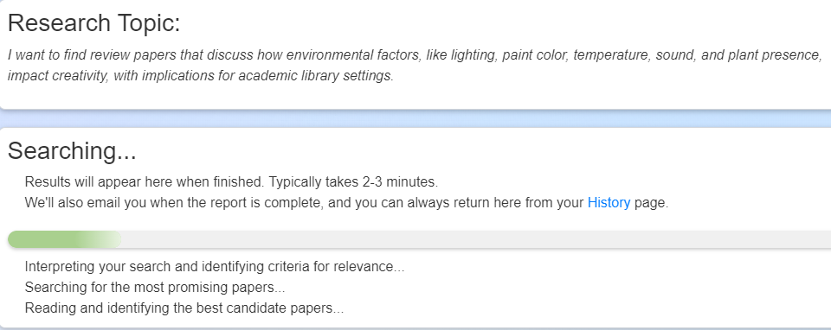
Undermind

Slide 10
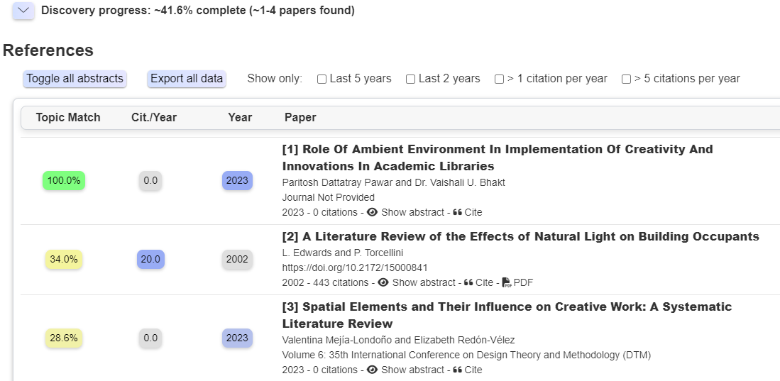
Undermind

Slide 11
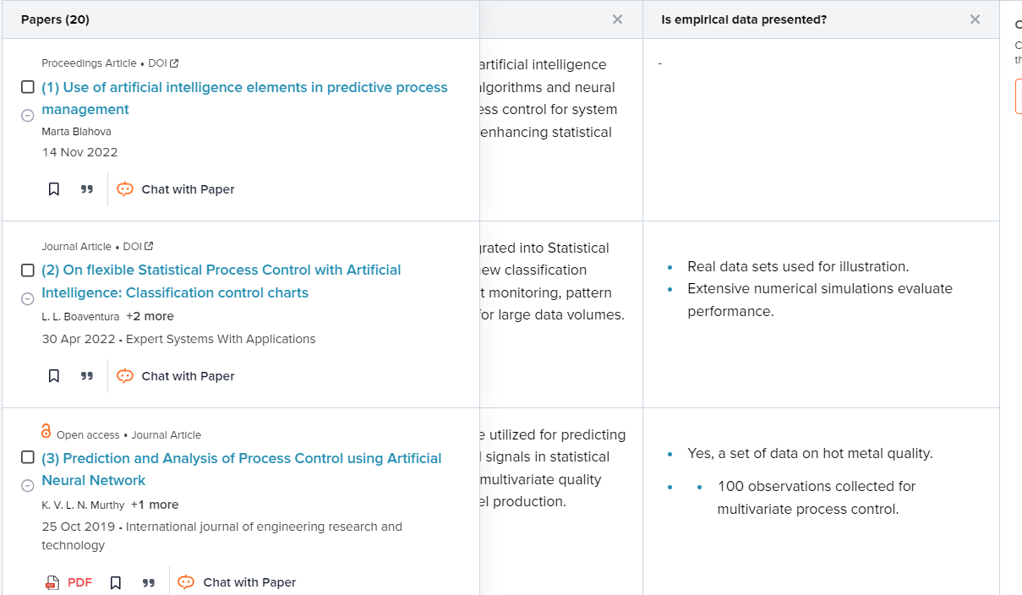
SciSpace

Slide 12
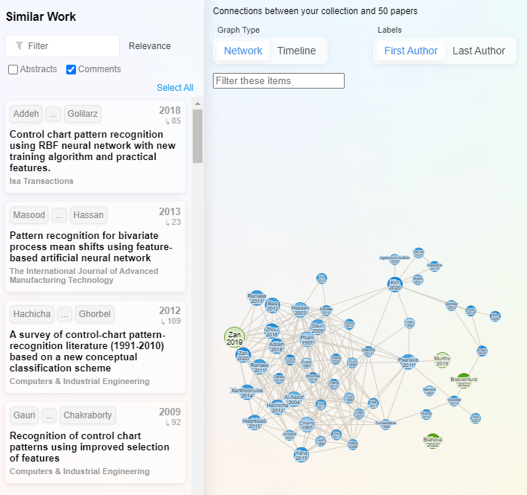
Research Rabbit

Slide 13
Resources for Learning More
Generative AI Product Tracker – https://bit.ly/ithaka-discovery
Aaron Tay– https://musingsaboutlibrarianship.blogspot.com/
https://guides.library.ttu.edu/artificialintelligencetools/aitools
AI for Faculty Handout– bit.ly/aibrarianshandout

