Slide 1
Google Scholar and Scopus
Jason Coleman (coleman@ksu.edu)
October 7, 2024

Slide 2
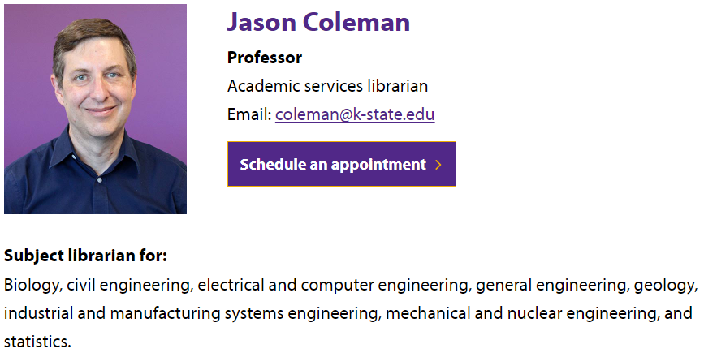
Presenter’s Contact Information
https://lib.k-state.edu/about/our-people/jason-coleman/

Slide 3
Overview
Size:
Unknown, but likely over 400 million records
Content:
journal and conference papers
theses and dissertations
academic books
pre-prints
abstracts
technical reports
court opinions
patents
miscellaneous (e.g., PowerPoints, posters)
Where Does the Information Come From?
Crawling institutional repositories
Crawling journal websites
Receiving information from publishers
https://scholar.google.com/intl/en/scholar/help.html

Slide 4
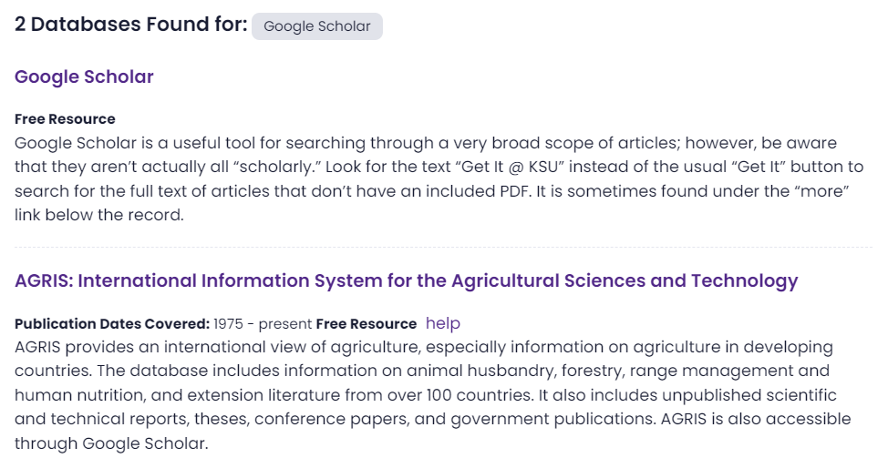
Access
Via Databases List

Slide 5
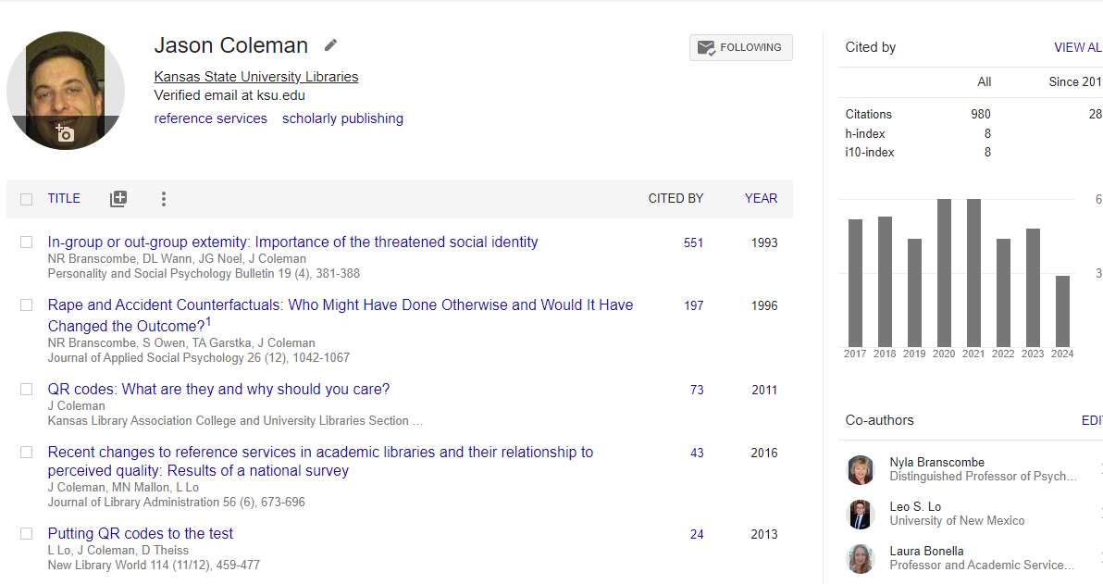
Account
Profile

Slide 6
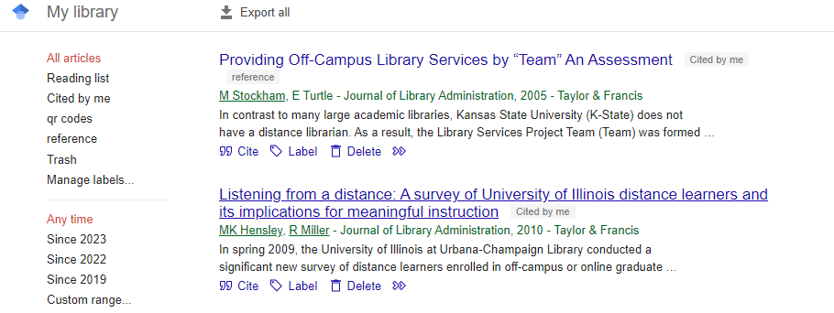
Account
My Library

Slide 7
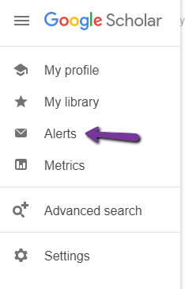
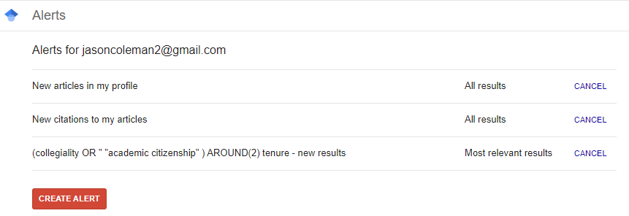
Account
Search Alerts

Slide 8
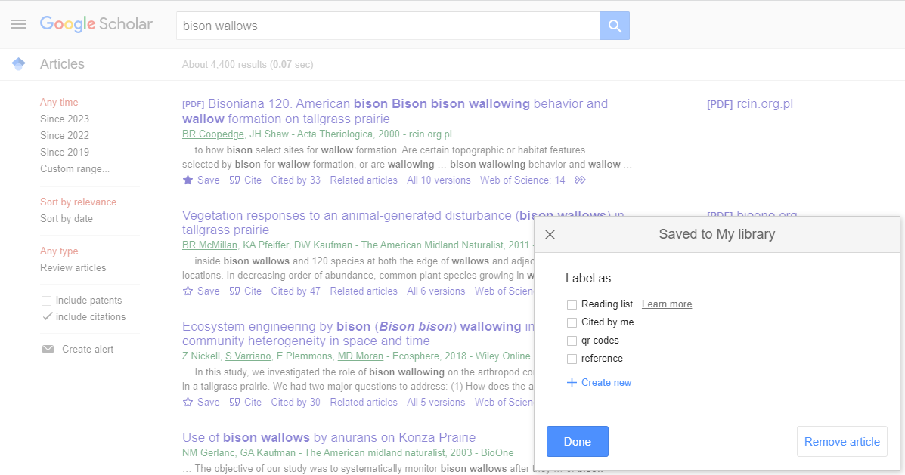
Results
Save to My Library

Slide 9
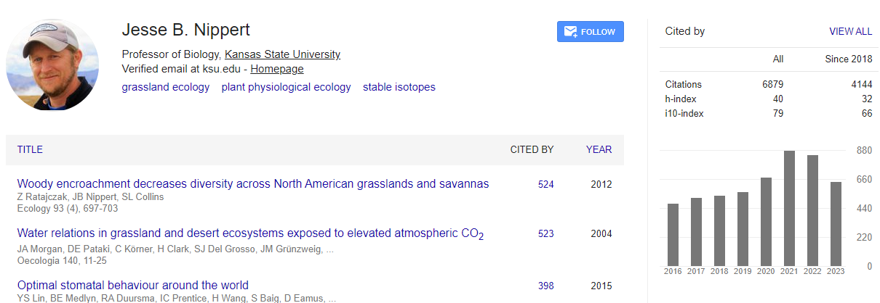
Results
View Author Profile

Slide 10
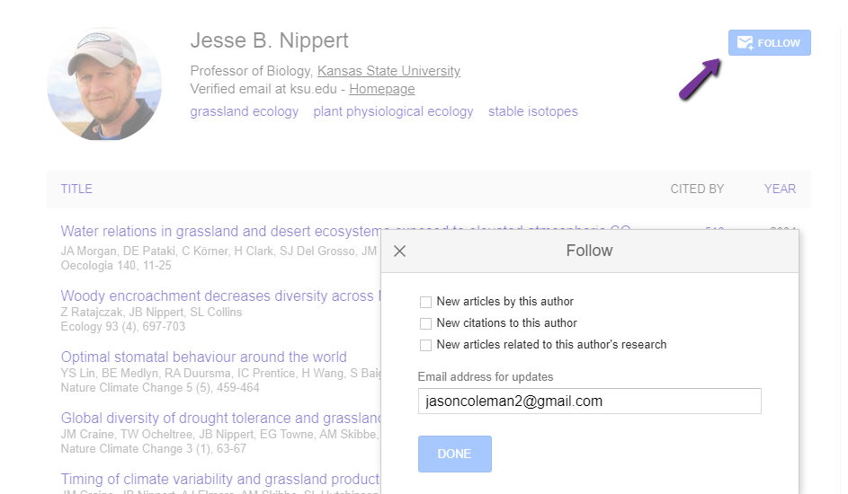
Results
Follow Author

Slide 11
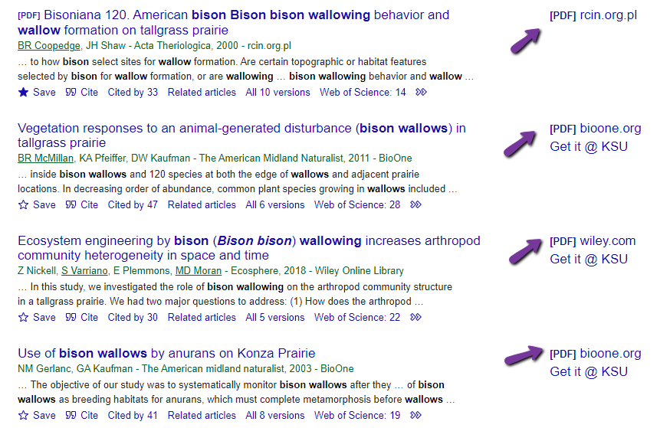
Results
Full Text Links

Slide 12
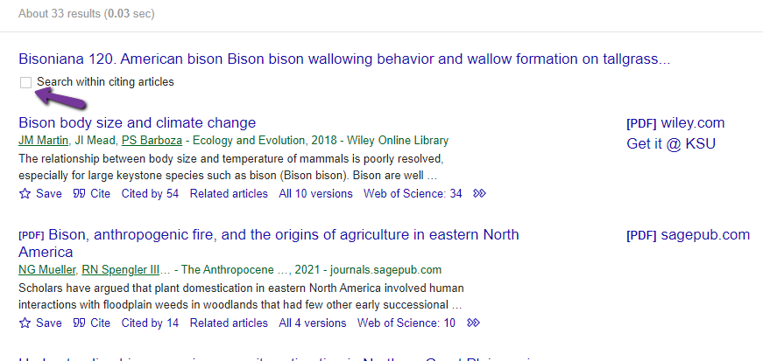
Results
Citing Articles

Slide 13
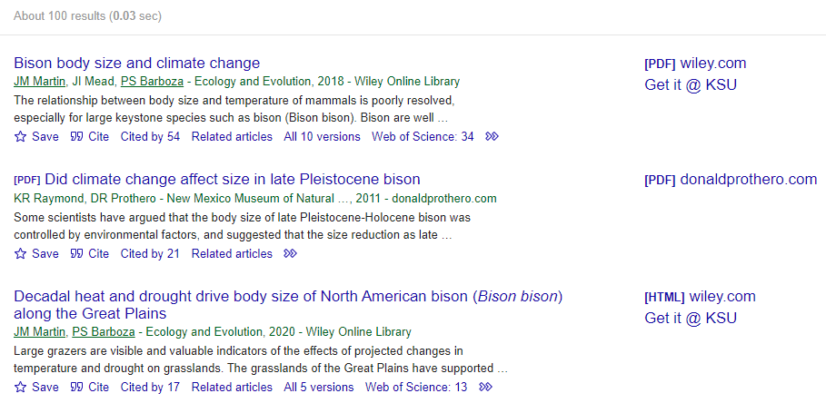
Results
Related Articles

Slide 14
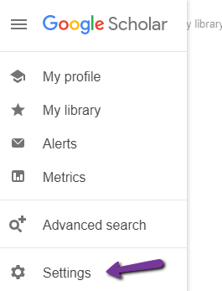
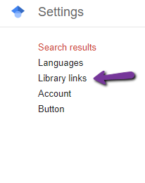
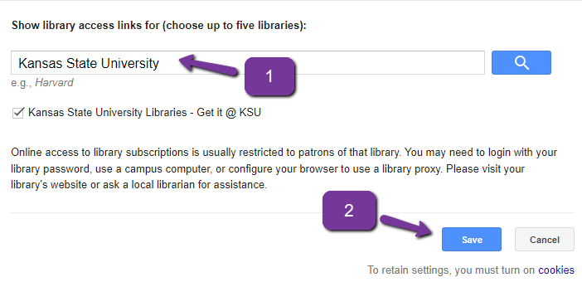
Results
Getting “Get @ KSU” to appear

Slide 15
Results
Getting “Get it @ KSU” to appear

Slide 16
Search Strategy
Identify keywords for your topic
Example: Methods cats use to communicate displeasure to humans
For each keyword develop a list of related terms – e.g., synonyms, broader terms, narrower terms. Link them together with OR.
Example: cats OR felines OR felis catus
Place phrases inside quotation marks
Example: cats OR felines OR “felis catus”
4. Group concepts inside parentheses and place AND between parentheses
Example: (cats OR felines OR “felis catus”) AND (methods OR techniques OR strategies OR mechanisms) AND (displeasure OR upset OR anger OR annoyance)

Slide 17
Proximity Searching
displeased cats
Returns results where both words are present. They can be any distance apart.
“displeased cats”
Returns results where both words are present with no spaces between them in the same order.
displeased w/3 cats
Returns results where both words are present. They must be within three words of one another in either order. Numbers other than 3 can be used.

Slide 18
Proximity Searching
Syntax varies from database to database
Google Scholar: AROUND(x)
Scopus: w/# (either order); pre/# (specified order)
Web of Science: NEAR/#
ProQuest: n/# (either order); p/# (specified order)

Slide 19
Wildcards
Match any number of characters
Google Scholar: can’t be done
Scopus: *
Example: displeas* matches displeased OR displeasure OR displeasing etc…
Example: *please matches displease OR unpleased etc…
Match one character
Google Scholar: can’t be done
Scopus: ?
Example: jo?n matches john OR joan

Slide 20
What is a Record?

Slide 21
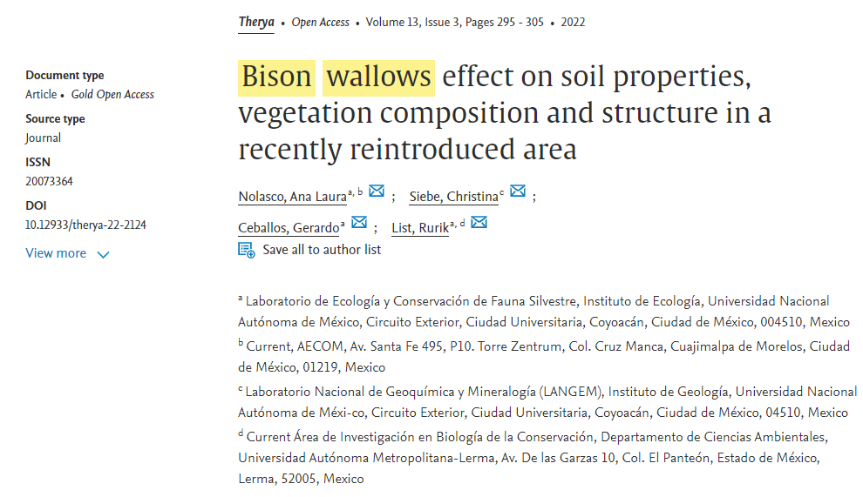
What is a Record?

Slide 22
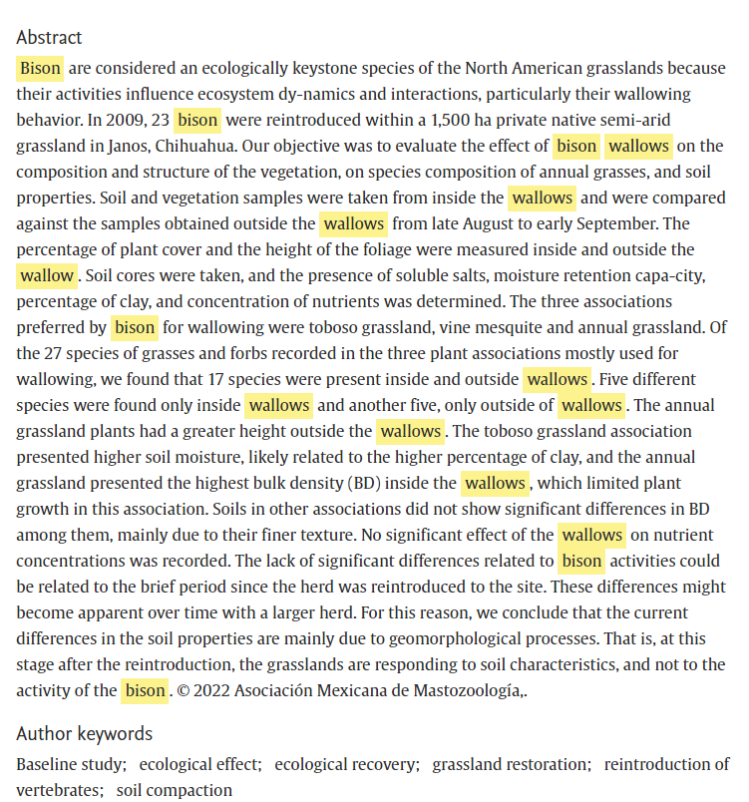
What is a Record?

Slide 23
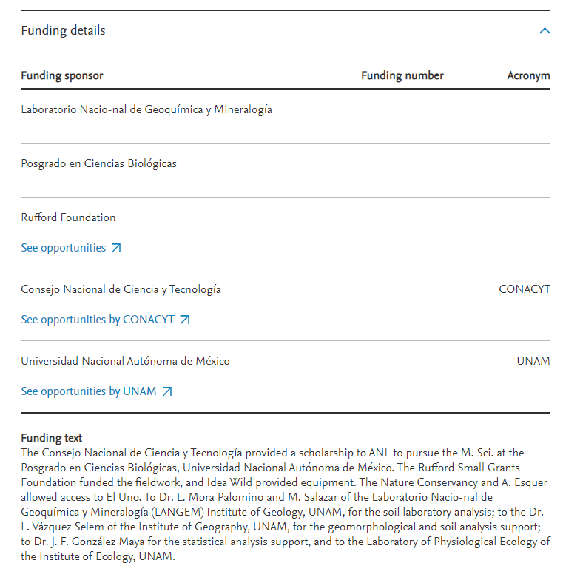
What is a Record?

Slide 24
Field Searching
When no field is specified, you are searching all fields as well as the full text
intitle: requires the word or phrase to be in the title
intitle:bison wallows
intitle:”bison wallows”
allintitle: requires all the words to be in the title
allintitle:bison wallows
source: requires the word or phrase to be in the name of the source
source:nature
author: requires the word or phrase to be in the author field
author:coleman

Slide 25
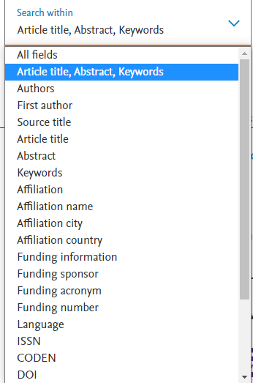
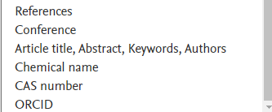
Field Searching

Slide 26
Combining Strategies

Slide 27
Overview
Size:
97+ million documents
Content:
journal and conference papers
academic books
preprints
Where Does the Information Come From?
Journals and books that meet Scopus’s inclusion criteria

Slide 28
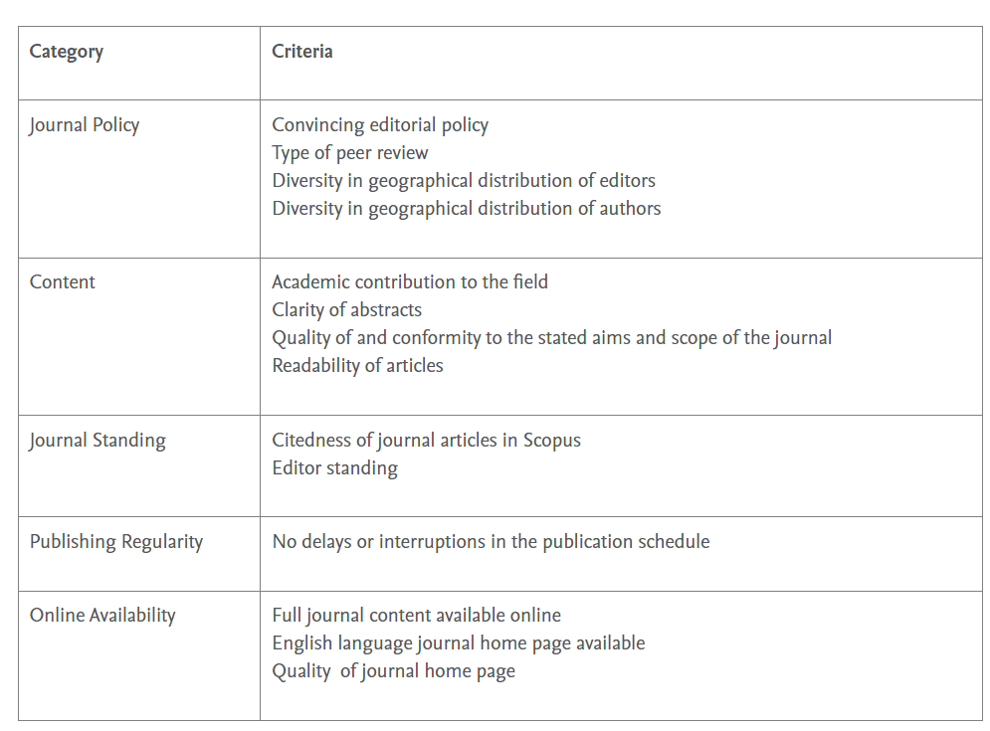
Overview
Inclusion Criteria
https://www.elsevier.com/solutions/scopus/how-scopus-works/content/content-policy-and-selection

Slide 29
Access
Via Databases List

Slide 30
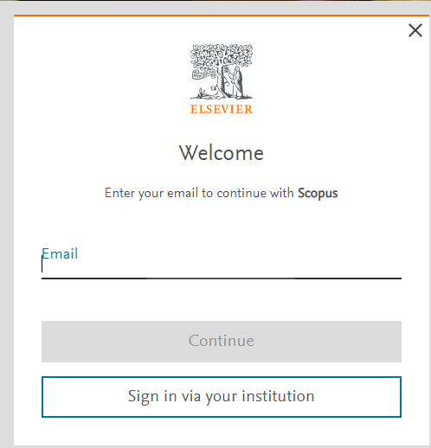
Account

Slide 31
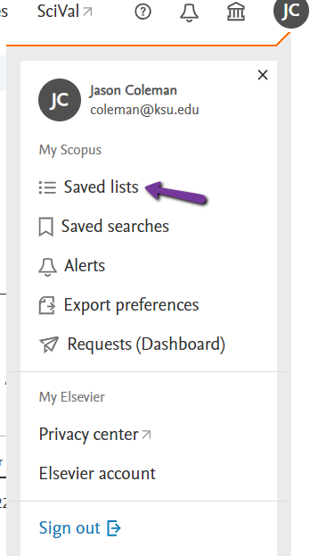
Account
Saved Lists

Slide 32
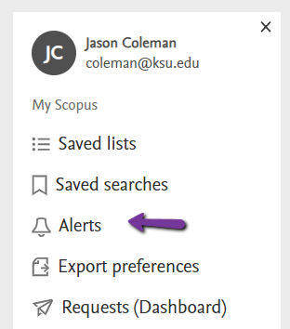
Account
Search Alerts

Slide 33
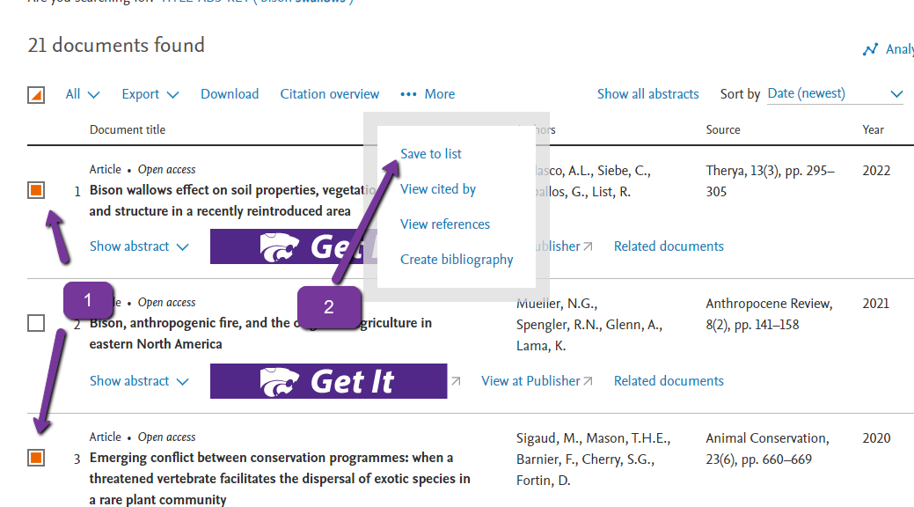
Results
Save Documents to List

Slide 34
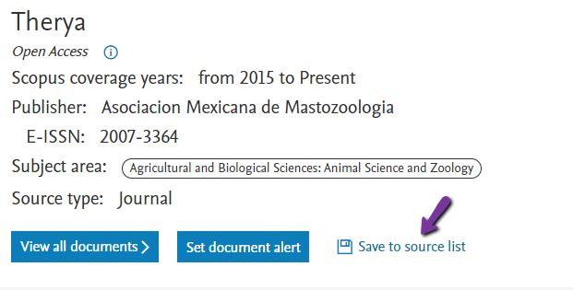
Results
Save Source to List

Slide 35
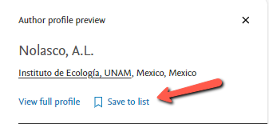
Results
Save Author to List

Slide 36
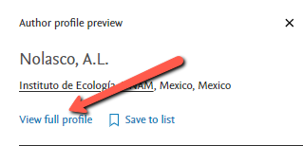
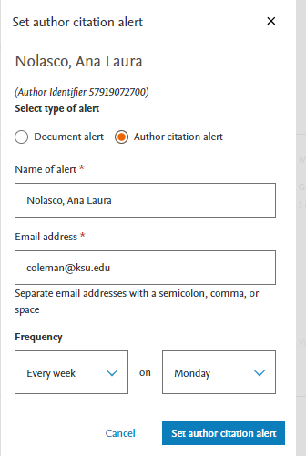
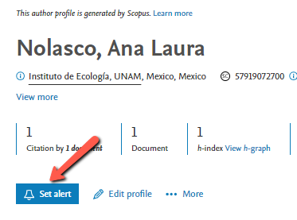
Results
Set author citation alert

Slide 37
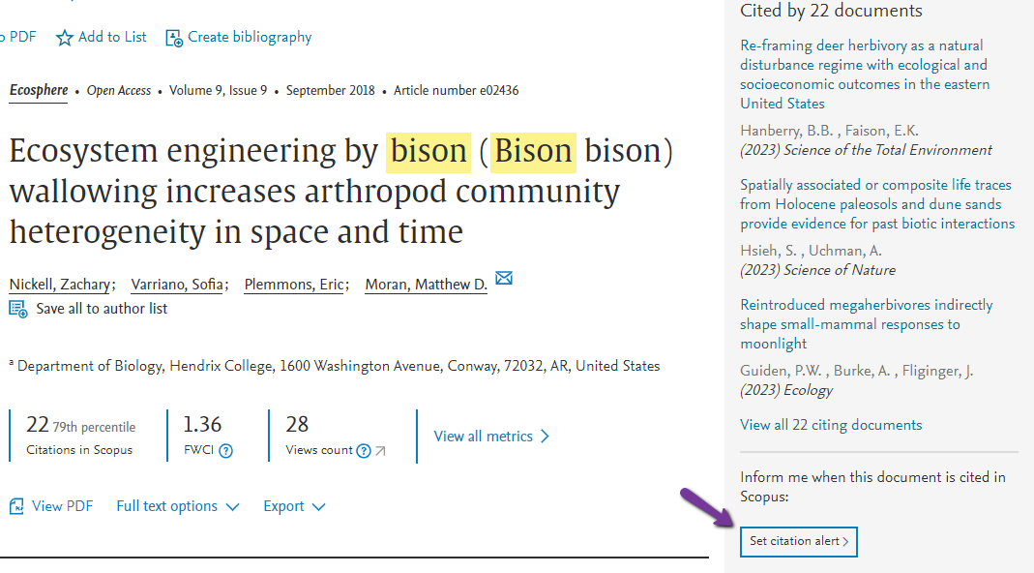
Results
Set document citation alert

Slide 38
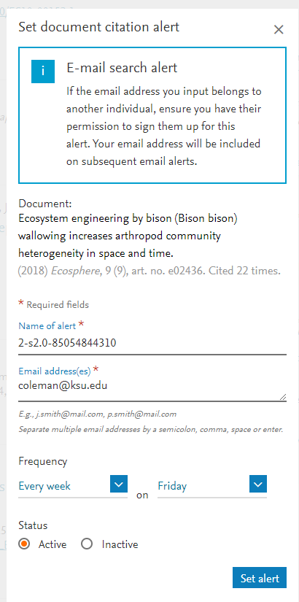
Results
Set document citation alert

Slide 39
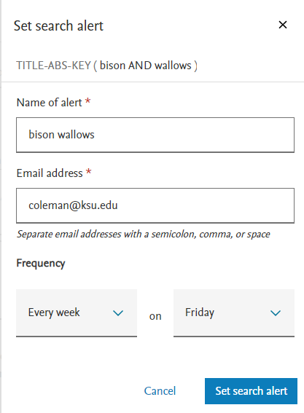
Results
Set search alert

Slide 40
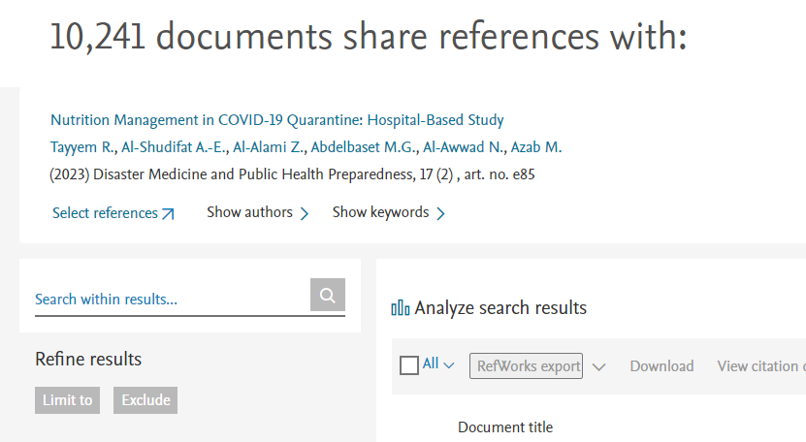
Results
Related Documents

Slide 41
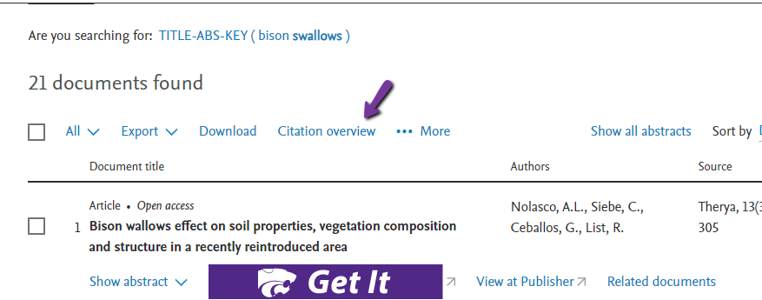
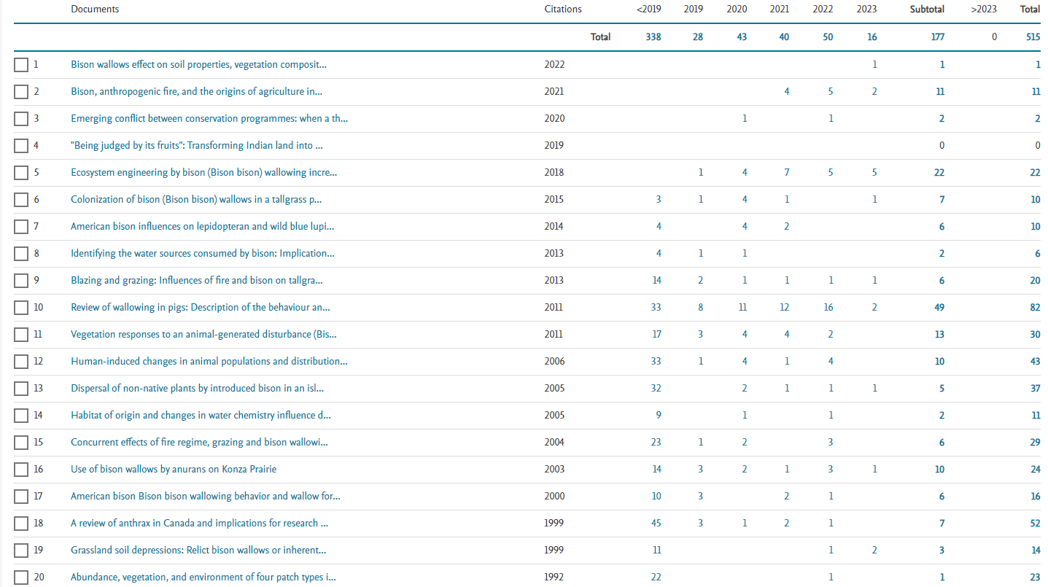
Results
Citation Overviews

Slide 42
Results
Analyze Search Results

Slide 43
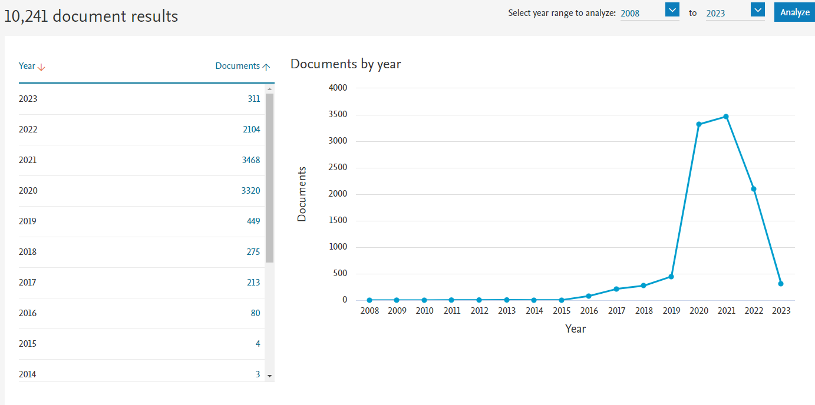
Results
Analyze Search Results

Slide 44
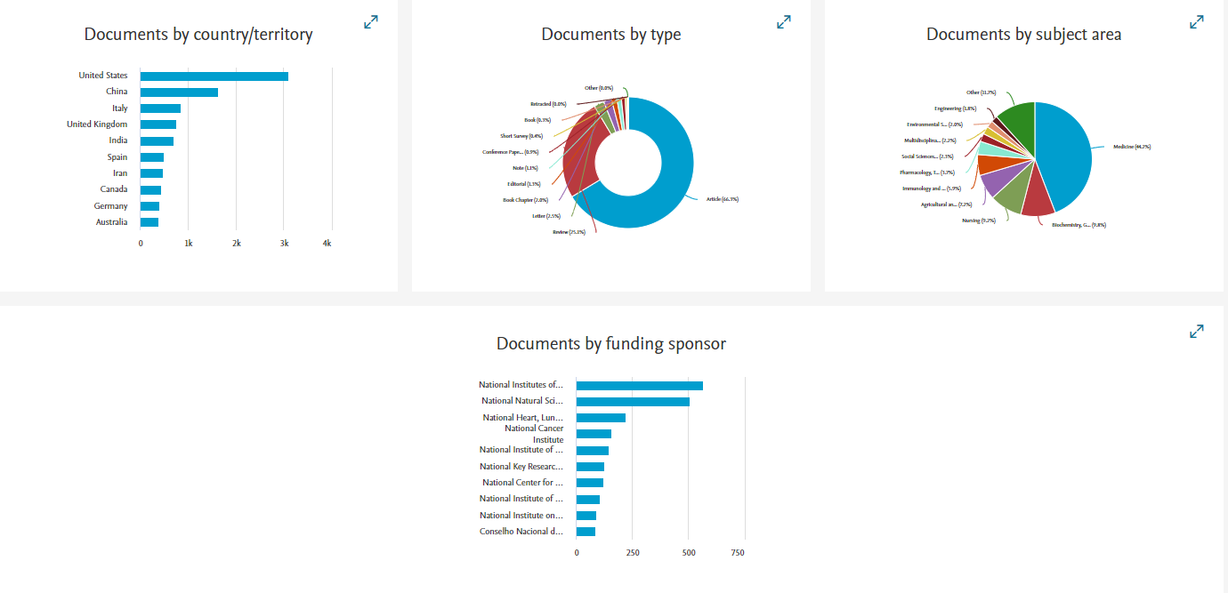
Results
Analyze Search Results

Slide 45
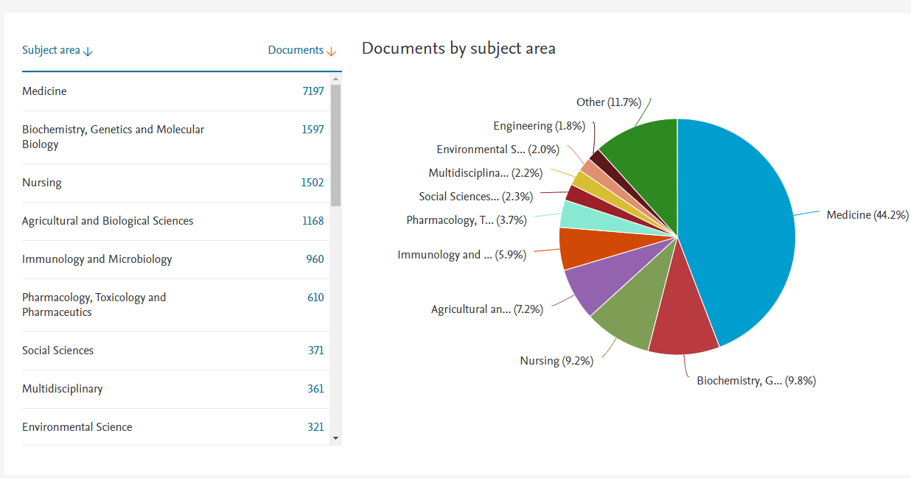
Results
Analyze Search Results
Documents by Subject Area

Slide 46
Organizations

Slide 47
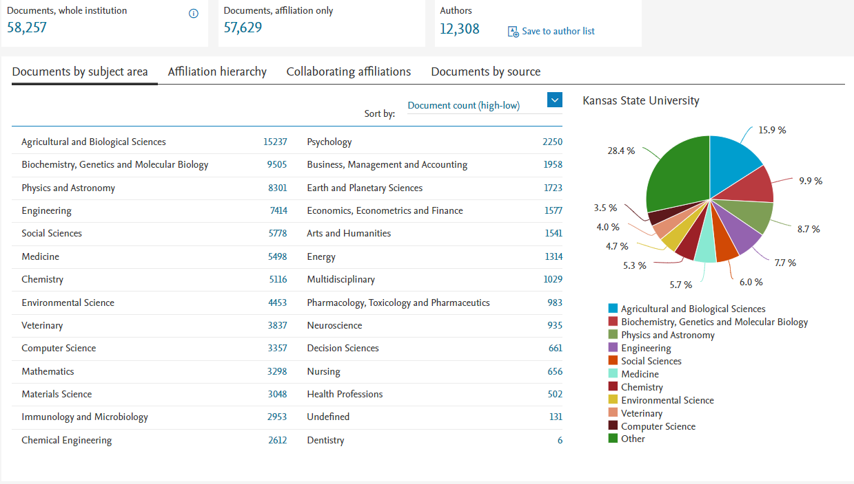
Organizations

Slide 48
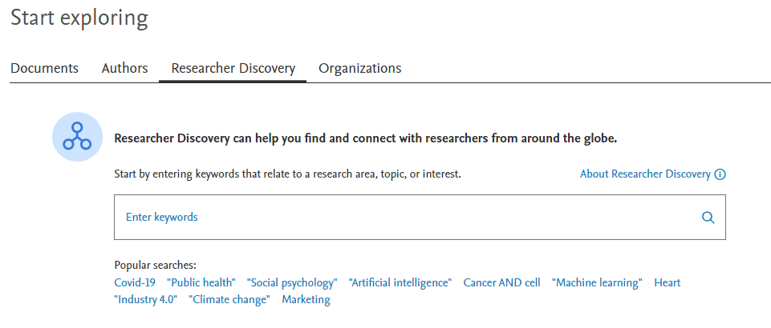
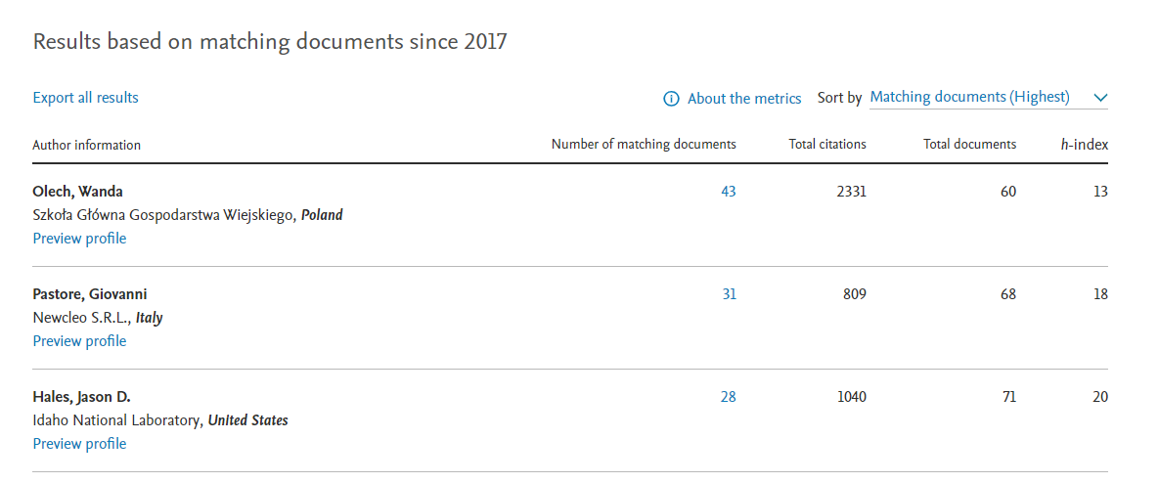
Discover Researchers

Slide 49
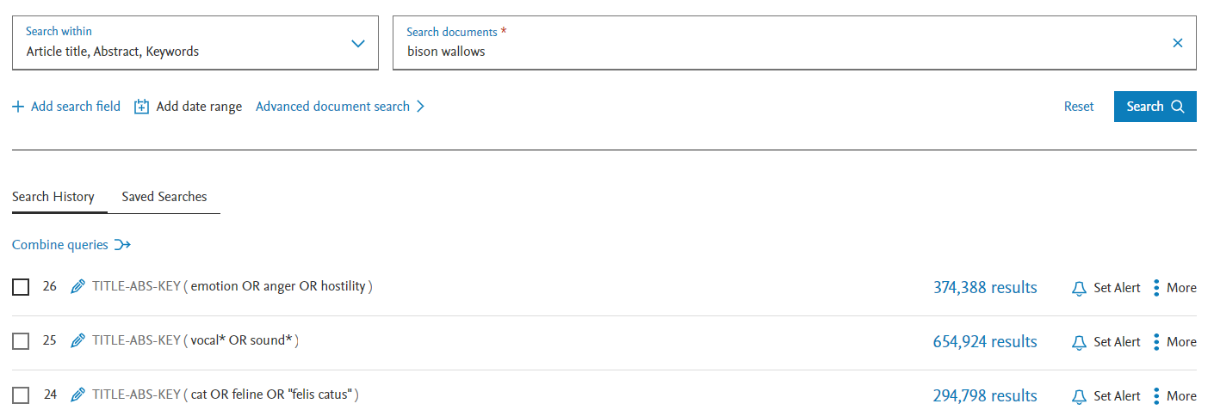
Combine results sets

Slide 50
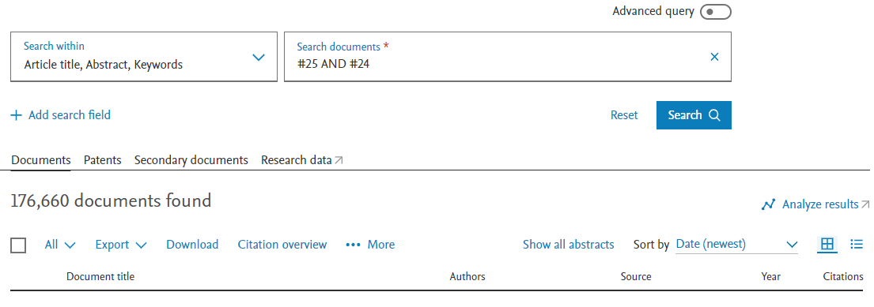
Combine results sets

Slide 51
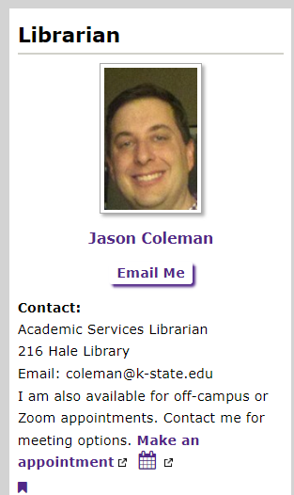
For Help

