Slide 1
The Library and Your Research: Copyright, ETDR, and Publishing
Ryan Otto (he/him)
Scholarly Communication Librarian – Associate Professor
Gwendolyn Sibley (she/her)
Copyright & Scholarly Communication Librarian – Assistant Professor

Slide 2
DISCLAIMER
The information presented in this presentation is intended for informational purposes and should not be construed as legal advice. If you have specific legal questions pertaining to K-State, please contact the Office of General Counsel. Information received from the Scholarly Communication Librarian is not legal advice. The Scholarly Communication Librarian does not act as legal counsel to the university or any members of the university community.

Slide 3
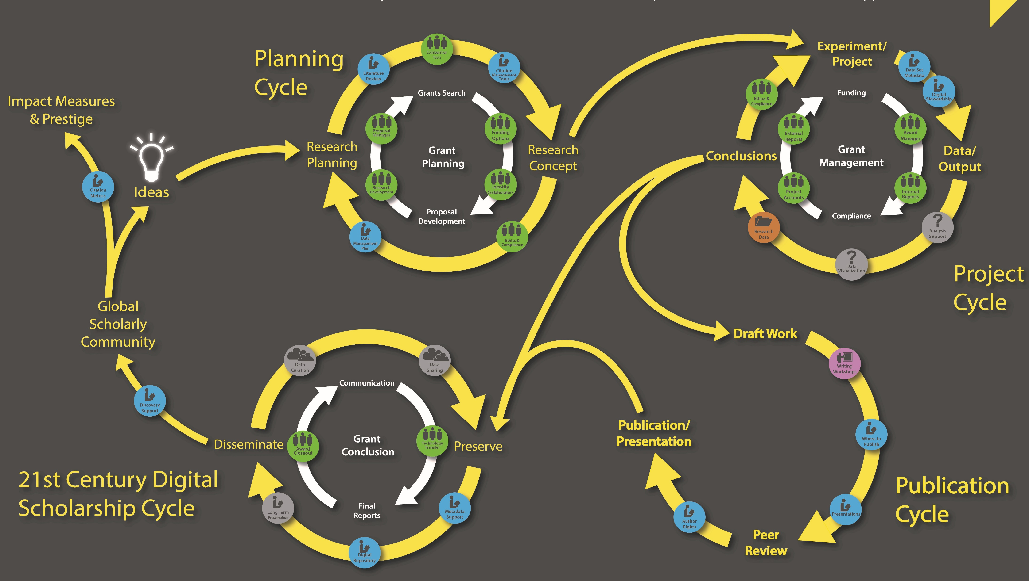
Research Lifecycle-Created by UCF-Licensed as CC BY-SA 3.0

Slide 4
Copyright Law
Let’s talk about your rights

Slide 5
Copyright and Patent Clause:
U.S. Constitution Article 1, Section 8, Clause 8
“The Congress shall have the power… To promote the Progress of Science and useful Arts, by securing for limited Times to Authors and Inventors the Exclusive Right to their respective Writings and Discoveries.”

Slide 6
Less Legalese Please!
Copyright is a Bundle of rights that protect original creative works.

Slide 7
What’s Protected under Copyright?
To Qualify, Works Must be:
Original
Creative
Fixed in a tangible medium of expression (i.e.):
Written on paper;
Be recorded audio or video;
Or be physical, like an architectural building.

Slide 8
Copyright is Automatic
Official Registration is not required for federal protection!
Registration Lets You:
Make your work discoverable in the Copyright Office Catalog
Provide better contact information for users of your work
File a lawsuit
Note: Registering cost various fees.

Slide 9
What’s Protected under Copyright?
Examples of Creative Works
Literature
Music
Photography
Film
</>
Art & Architecture
Live Recordings
Software Code
Choreography

Slide 10
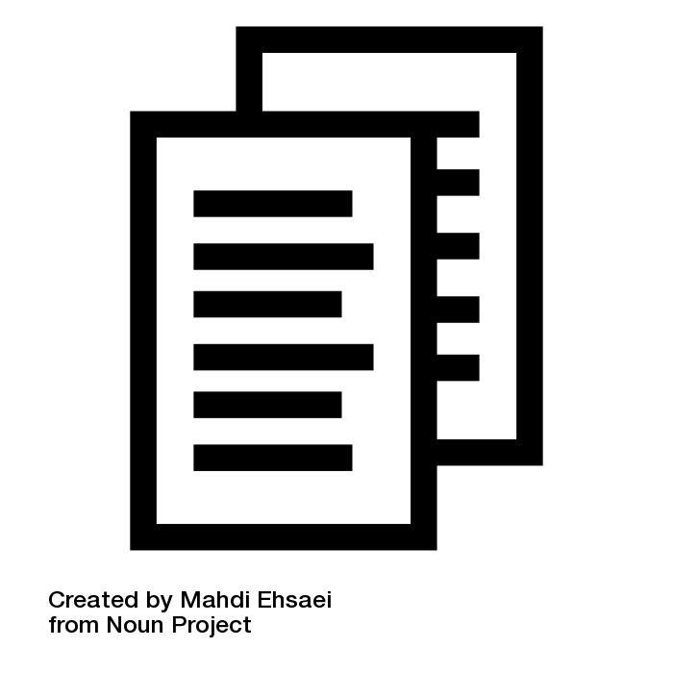
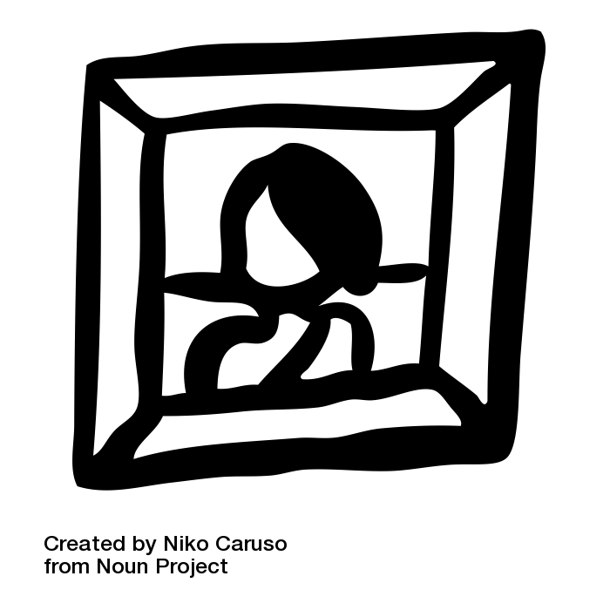
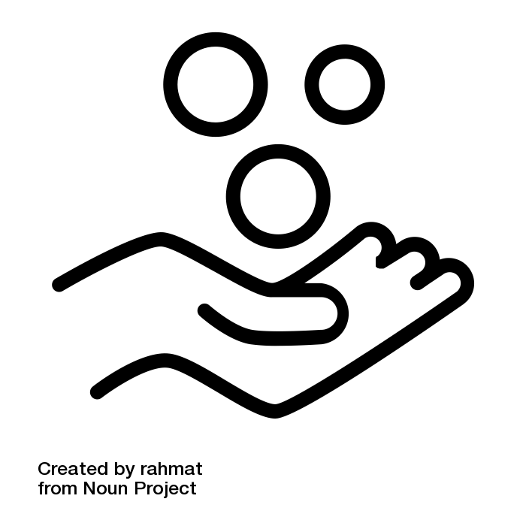
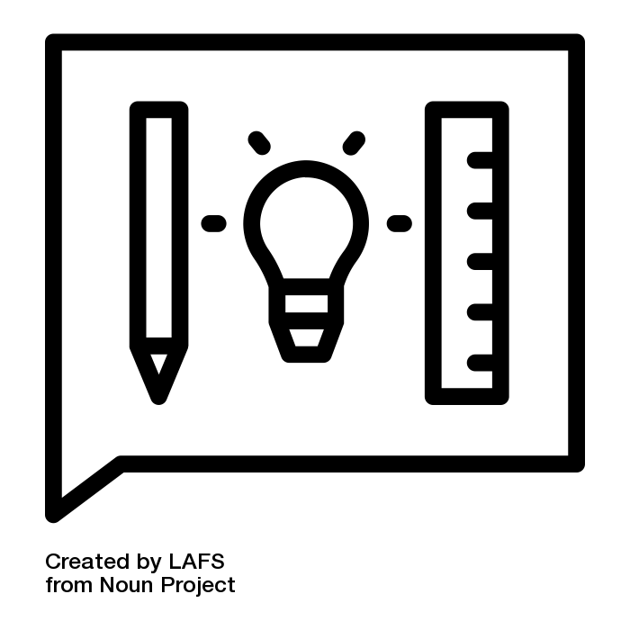
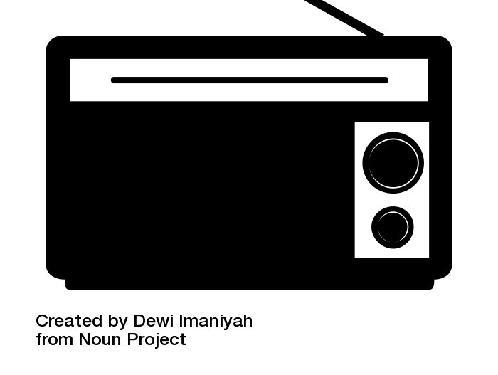
Bundle of Rights allow you to:
Reproduce & Make Copies
Distribute Copies
Display Works Publicly
Prepare Derivative Works
Perform Works Publicly
Perform Works Publicly through Digital Audio Transmission
https://www.youtube.com/watch?v=2U81MTBg5tY
Notes:
Copyright is a form of intellectual property protection codified in title 17 of the US Code. When one retains copyright in a work they actually hold a bundle of rights– this bundle broken down includes the rights to:
(1)to reproduce the copyrighted work in copies or phonorecords;
(2)to prepare derivative works based upon the copyrighted work;
(3)to distribute copies or phonorecords of the copyrighted work to the public by sale or other transfer of ownership, or by rental, lease, or lending;
(4)in the case of literary, musical, dramatic, and choreographic works, pantomimes, and motion pictures and other audiovisual works, to perform the copyrighted work publicly;
(5)in the case of literary, musical, dramatic, and choreographic works, pantomimes, and pictorial, graphic, or sculptural works, including the individual images of a motion picture or other audiovisual work, to display the copyrighted work publicly; and
(6)in the case of sound recordings, to perform the copyrighted work publicly by means of a digital audio transmission.

Slide 11
What’s Not Protected:
1.
Facts & Data
2.
Ideas
3.
Names & Slogans
4.
Useful Articles
A selfie taken in 2011 by Naruto, a monkey in Indonesia.
Credit...David Slaters/Caters News
Notes:
Facts & Data
Compilation of data may be
Ideas
but could fall under patent law
Names, slogans, symbols, short phrases
may fall under trademark
Useful articles
items like lamps, kitchen sinks, clothing

Slide 12
What’s Not Protected:
1.
Facts & Data
2.
Ideas
3.
Names & Slogans
4.
Useful Articles
Not Creative
Not Fixed
Part of TrademarkLaw
Not Original
Notes:
Facts & Data
Compilation of data may be
Ideas
but could fall under patent law
Names, slogans, symbols, short phrases
may fall under trademark
Useful articles
items like lamps, kitchen sinks, clothing

Slide 13
What’s also Not Protected:
Non-Human Creations:
Works Created by Animals
Works generated by Artificial Intelligence (AI)
Natural objects such as rocks or trees
Naruto v. Slater, No. 16-15469 (9th Cir. 2018) :: Justia
A selfie taken in 2011 by Naruto, a monkey in Indonesia.
Credit...David Slaters/Caters News
Notes:
Facts & Data
Compilation of data may be
Ideas
but could fall under patent law
Names, slogans, symbols, short phrases
may fall under trademark
Useful articles
items like lamps, kitchen sinks, clothing

Slide 14
Determining Copyright
Let’s look at an example

Slide 15
Scenario:
I have found the perfect chocolate fudge recipe online.
What elements of the recipe have copyright protection?
(Image next slide)

Slide 16
What elements of this recipe have copyright protection?

Slide 17
Copyrightable?
Yes or No?
Recipes are a list of facts & instruction

Slide 18
Photos: Are they a form of “creative expression?”
Copyrightable?
Yes or No?

Slide 19
Your Copyrights
What do you own?

Slide 20
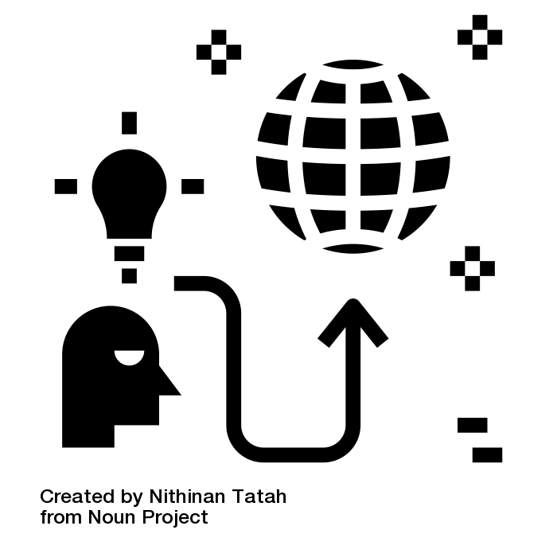
Who Owns Copyright?
or
The First owner is Author/Creator
Creator’s employer if the work was “made for hire”
These authors can transfer or license any of their exclusive rights.
Notes:
At the beginning of any project and before signing any contracts for content make sure ownership is clear to all involved parties.

Slide 21
Works are “made for hire” if:
Prepared by an employee acting within the scope of employment OR
is one of the 9 types of works that a contract can turn into a work made for hire, and a contract was signed before the work was created.
As a contribution to a collective work.
As a part of a motion picture or other AV work.
As a translation.
As a supplementary work.
As a compilation.
As an instructional text.
As a test.
As an answer material for a test.
As an atlas
For more information on “Work for Hire” visit: https://www.copyright.gov/circs/circ30.pdf
Notes:
Its important to be clear when starting any position you understand what your job considers to be work for hire since “scope of employment is vague”

Slide 22
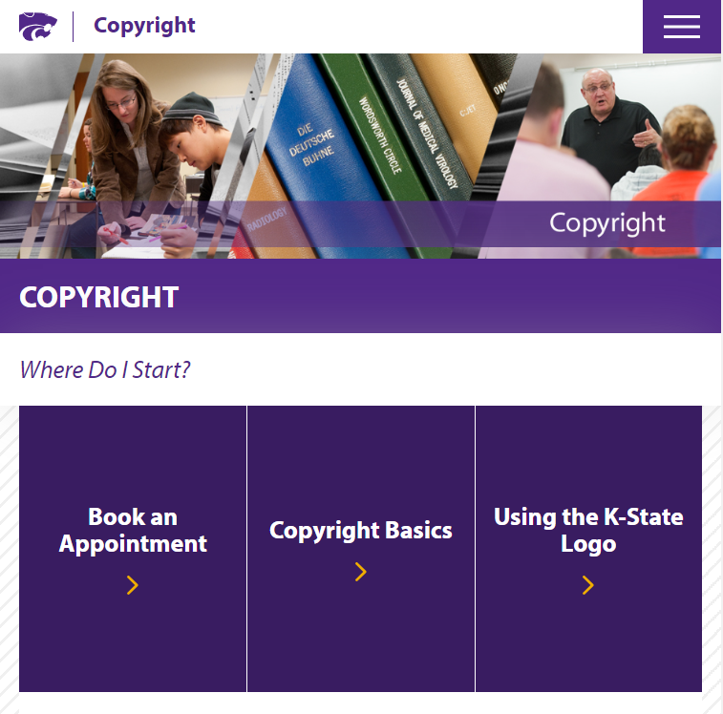
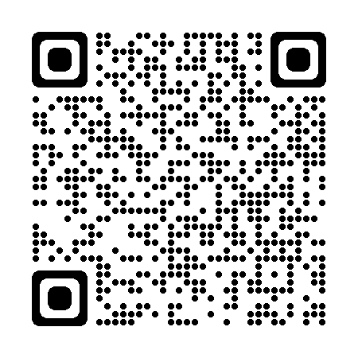
Copyright Services
https://www.k-state.edu/copyright/

Slide 23
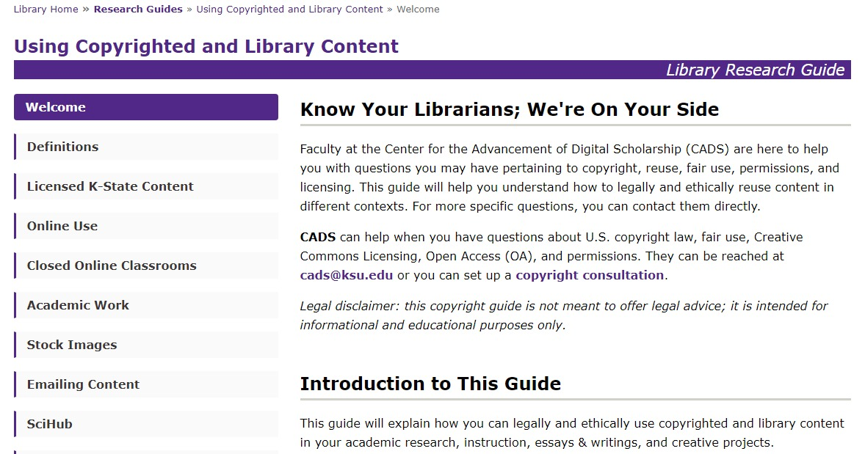
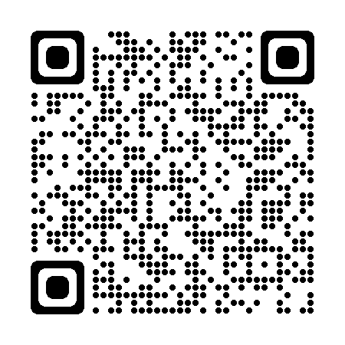
Resources
https://guides.lib.k-state.edu/UsingContent

Slide 24
Copyright & Your ETDR
Finding and Using Works for your Studies.

Slide 25
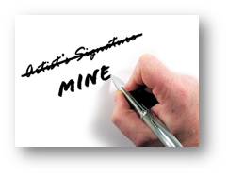
Copyright (Law) vs. Plagiarism (Ethics)
Copyright is a legal concept it’s a codified right with legal penalties.
Plagiarism is an ethical issue with academic or professional penalties.
Credit RyanMinkoff

Slide 26
Framework - U.S. Copyright
Does it have copyright protection?
Does it have an existing license that covers my use?
Can I rely on an exemption, such as fair use?
Do I need to seek permission or purchase a license?
Rights
License
Exemption(s)
Permission

Slide 27
Rights
1. Does it have copyright protection?
Original
Creative
And Fixed
OR
2. Has the copyright expired?
Public Domain

Slide 28
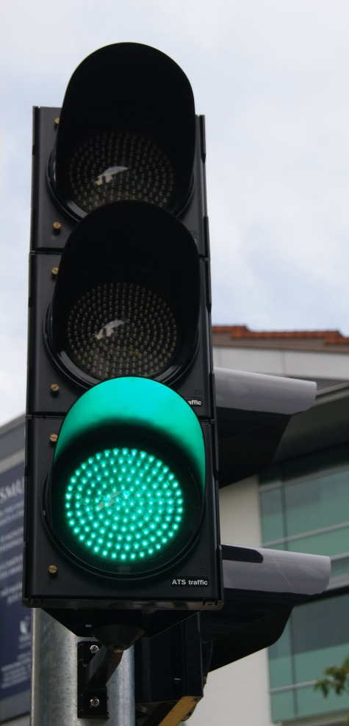
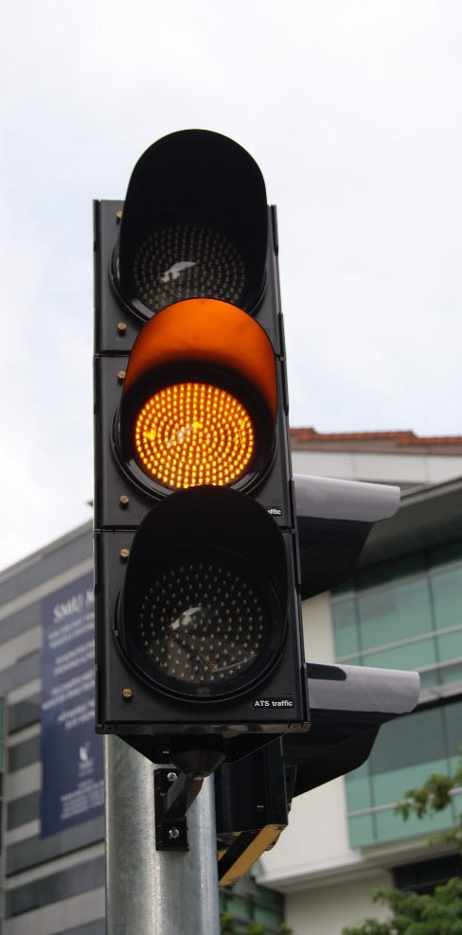
Is the work in the Public Domain?
All works published from 1929*
Works published between 1929 and 1989
Works created after 1989*
Images courtesy of Jacklee at Wikimedia Commons.

Slide 29
Public Domain Tools
https://copyright.cornell.edu/publicdomain
https://librarycopyright.net/resources/digitalslider/index.html

Slide 30
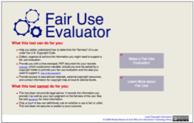
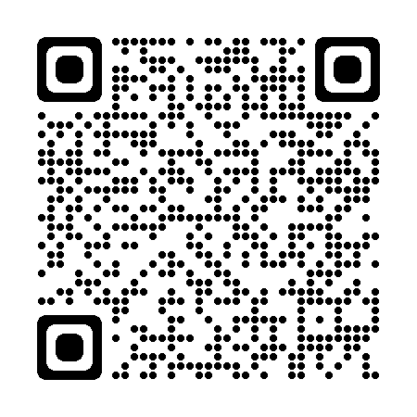
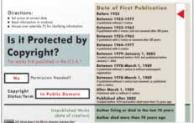
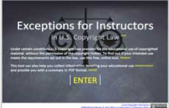
Helpful Tools
The Copyright Genie
Fair Use Evaluator
Public Domain Slider
Exceptions for Instructors eTool
https://librarycopyright.net/resources/

Slide 31
Framework - U.S. Copyright
Does it have copyright protection?
Does it have an existing license that covers my use?
Can I rely on an exemption, such as fair use?
Do I need to seek permission or purchase a license?
Rights
License
Exemption(s)
Permission

Slide 32
3. Do any user’s rights, such as fair use, apply?
Fair use (107) can be used for purposes such as:
criticism,
comment,
news reporting,
teaching (including multiple copies for classroom use),
scholarship,
or research

Slide 33
Fair Use Basics
Purpose
Nature
Amount
Transformativeness, Not-for-Profit/Profit, Use is for "criticism, comment, news reporting, teaching, (including multiple print copies for classroom use), scholarship or research"…or not?
Effect
Published/unpublished, factual/creative, consumable?
Limited and Reasonable. Not the “heart of the work.”
How much will the use harm the market for the work?

Slide 34
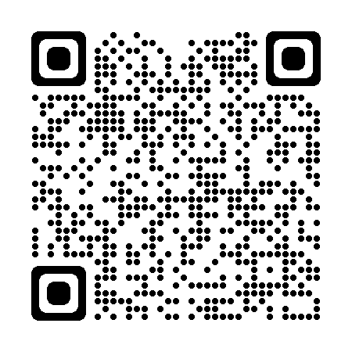
Fair Use Evaluator Highly Recommend Learning More About Fair Use and How to Use It

Slide 35
License
Copyright, Licenses and Transfers
Contracts/agreements that permits authority to own, do, or use something.
© is a bundle of rights
Rights holders can transfer or license any of their exclusive rights, including portions of those rights.
Does transferring a physical object transfer copyright in that object?--No

Slide 36
Public Licenses
Rights holder - Licensor
Everybody else - Licensee
Public, or open licenses last until the work enters the public domain at the end of the copyright term.
(Unless termination rights are exercised)

Slide 37
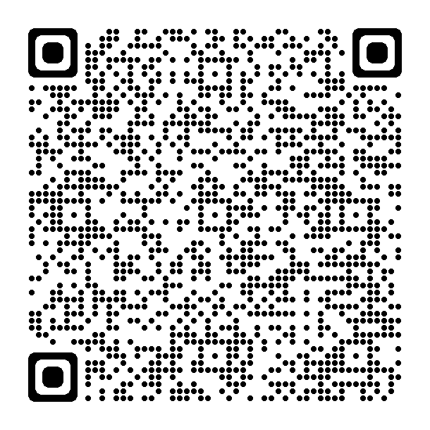
How to Use Tables Charts & Graphs in Your ETDR and Publications
Region and country of last residence¹ | 2010 to 2019 | 2020 | 2021
Total | 10,633,446 | 707,362 | 740,002
Europe | 906,816 | 70,284 | 60,744
Asia | 4,062,777 | 260,706 | 283,898
America | 4,433,094 | 275,790 | 300,808
South America | 784,683 | 60,237 | 69,058
Africa | 1,037,674 | 76,789 | 64,983
GOOD. “Transparency: Who Is Coming to America?,” May 7, 2009. https://www.good.is/infographics/transparency-who-is-coming-to-america.
https://deepblue.lib.umich.edu/bitstream/handle/2027.42/83329/copyrightability_of_tables_charts_and_graphs.pdf?sequence=1&isAllowed=y

Slide 38
Publishing & Your ETDR
Make sure you read your license agreement.

Slide 39
ETDR HELP
Questions about these topics:
Graduation procedures, requirements and deadlines
ETDR fees
Embargo (request for delayed publication in K-REx)
Commencement
Questions about these topics:
Templates and formatting your ETDR
Reviewing your ETDR and supplemental files
Working with image or audio files
Converting your Word or LaTeX file to PDF
Logging into K-REx to submit your ETDR
Graduate School
119 Eisenhower Hall
785-532-6191 or 800-651-1816
grad@k-state.edu
IT Help Desk
Students Should Fill out the ETDR Request Form
785-532-7722 or 800-865-6143
helpdesk@k-state.edu

Slide 40
Key Functions of Scholarly Communication
Registration - to establish that work had been undertaken by individuals or groups of researchers at a particular time, and thus their claim to precedence;
Certification - to establish the validity of the findings;
Dissemination - to make scholarly works and their findings accessible and visible;
Preservation - to ensure that the 'records of science' are preserved, and remain accessible, for the long term.
What about Evaluation?
Directorate-General for Research and Innovation (European Commission) - Future of scholarly publishing and scholarly communication

Slide 41
Key Actors
The researchers, of course!
Research institutions (in particular universities)
Research funders and policy makers
Publishers and other providers
Society at large (practitioners, educators, citizen scientists, decision makers, patients and other users of reliable knowledge, etc.
Directorate-General for Research and Innovation (European Commission) - Future of scholarly publishing and scholarly communication

Slide 42
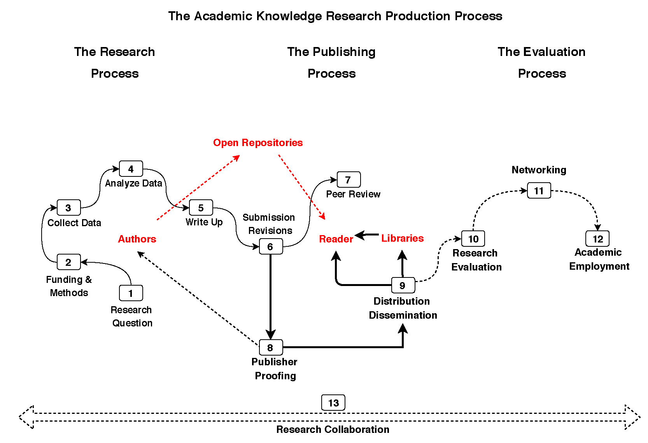
The Academic Knowledge
Production Process
The Research Process
Alejandro Posada, George Chen. Inequality in Knowledge Production: The Integration of Academic Infrastructure by Big Publishers. Leslie Chan; Pierre Mounier. ELPUB 2018, Jun 2018, Toronto, Canada. 〈10.4000/proceedings.elpub.2018.30

Slide 43
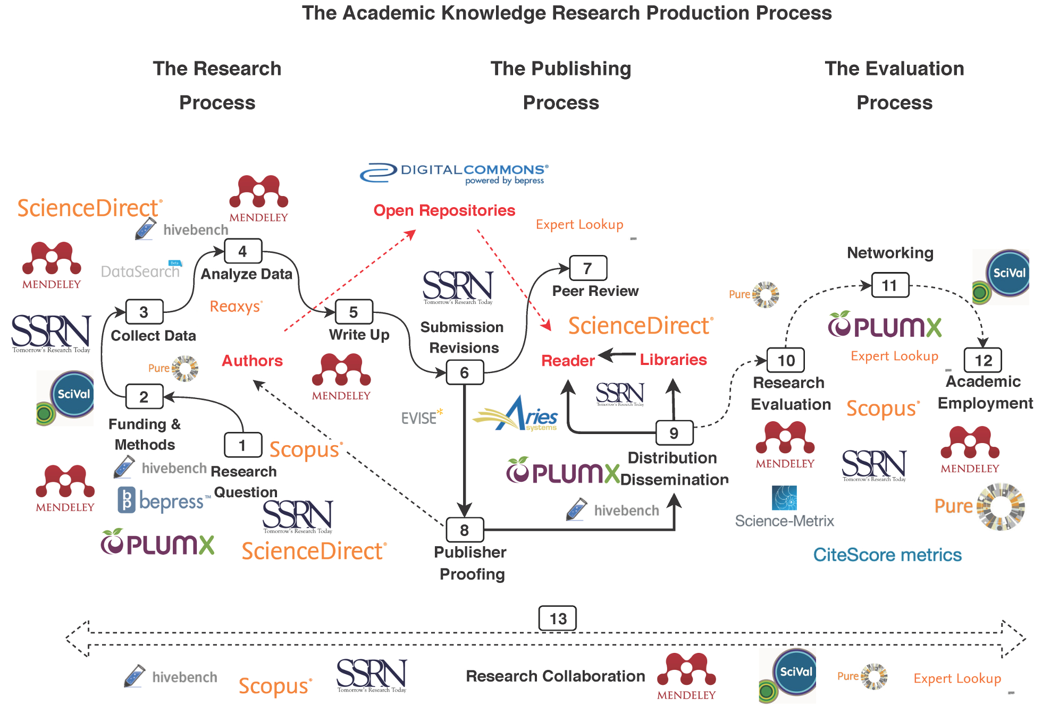
The Academic Knowledge
Production Process
Alejandro Posada, George Chen. Inequality in Knowledge Production: The Integration of Academic Infrastructure by Big Publishers. Leslie Chan; Pierre Mounier. ELPUB 2018, Jun 2018, Toronto, Canada. 〈10.4000/proceedings.elpub.2018.30

Slide 44
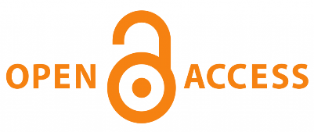
Question: Does more OA in a Hybrid Journal mean it has a lower subscription price?
Publishing Business Models
Manuscript Accepted — Author Pays $ APC
Author(s) Retain © — Creative Commons License
Distribution
Rights Management
Payment
Research Process
Write Up; Submission
Peer Review and Revisions
Manuscript Accepted
© Assigned to Publisher
Distribution — Reader Pays $
HYBRID
Payment

Slide 45
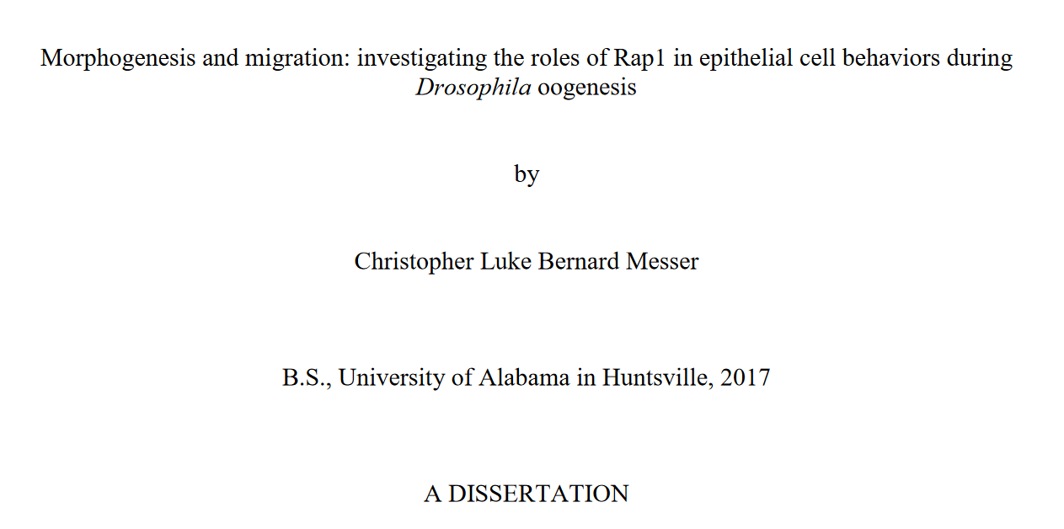
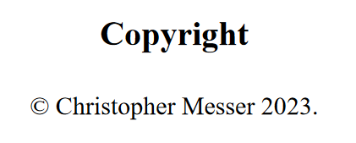
Copyright for an ETDR
All Rights Reserved by Author
Item is protected by copyright and/or related rights. You are free to use this Item in any way that is permitted by the copyright and related rights legislation that applies to your use. For other uses you need to obtain permission from the rights-holder(s).

Slide 46
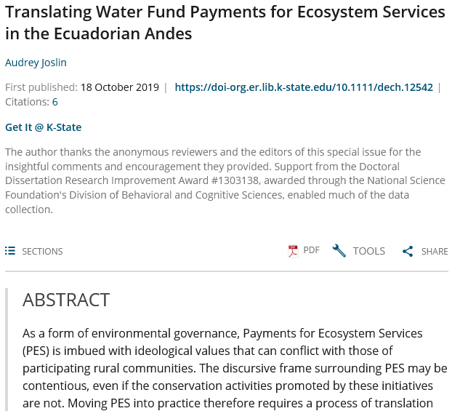
Subscription Journal Article
All Rights Reserved by Publisher
Item is protected by copyright and/or related rights. You are free to use this Item in any way that is permitted by the copyright and related rights legislation that applies to your use. For other uses you need to obtain permission from the rights-holder(s).

Slide 47
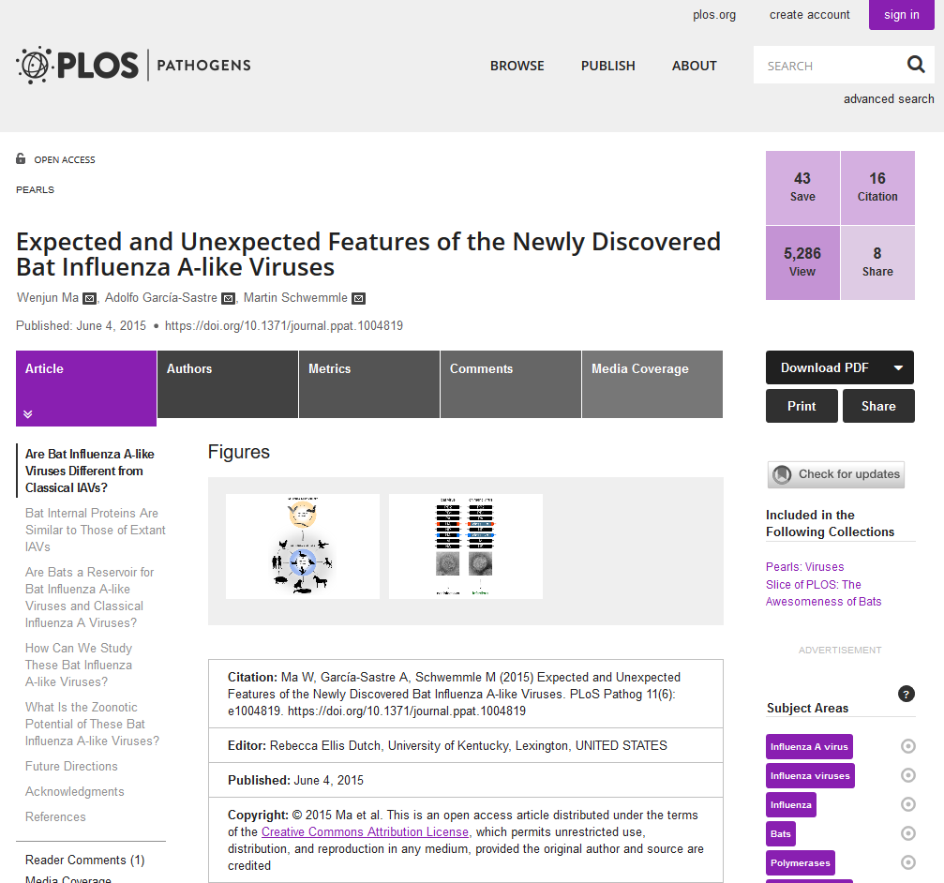
Gold-APC Open Access
Creative Commons BY
Share — copy and redistribute the material in any medium or format
Adapt — remix, transform, and build upon the material for any purpose, even commercially.

Slide 48
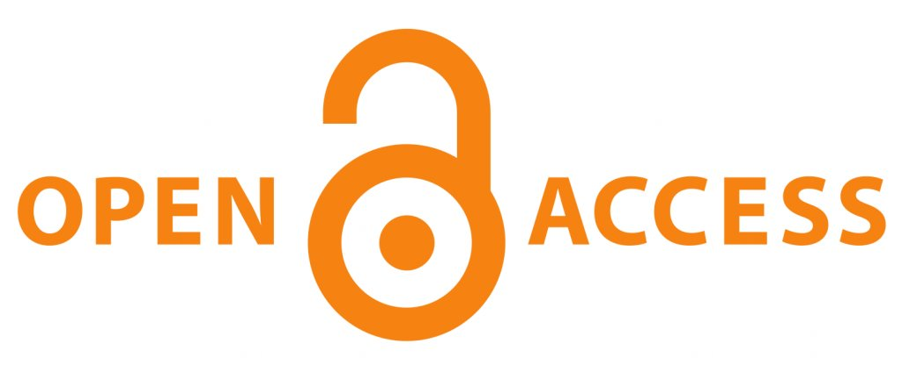
Rights Map
Gold-APC
Or
Diamond OA
FREE to
ALL
SOME Rights Reserved
Public Doman
ALL Rights Reserved
Time Passes or Creative Commons 0

Slide 49
What is Open Access?
Open-access (OA) literature is digital, online, free of charge, and free of most copyright and licensing restrictions.
What makes it possible is the internet and the consent of the author or copyright-holder.
-Peter Suber, Director of the Harvard Office for Scholarly Communication

Slide 50
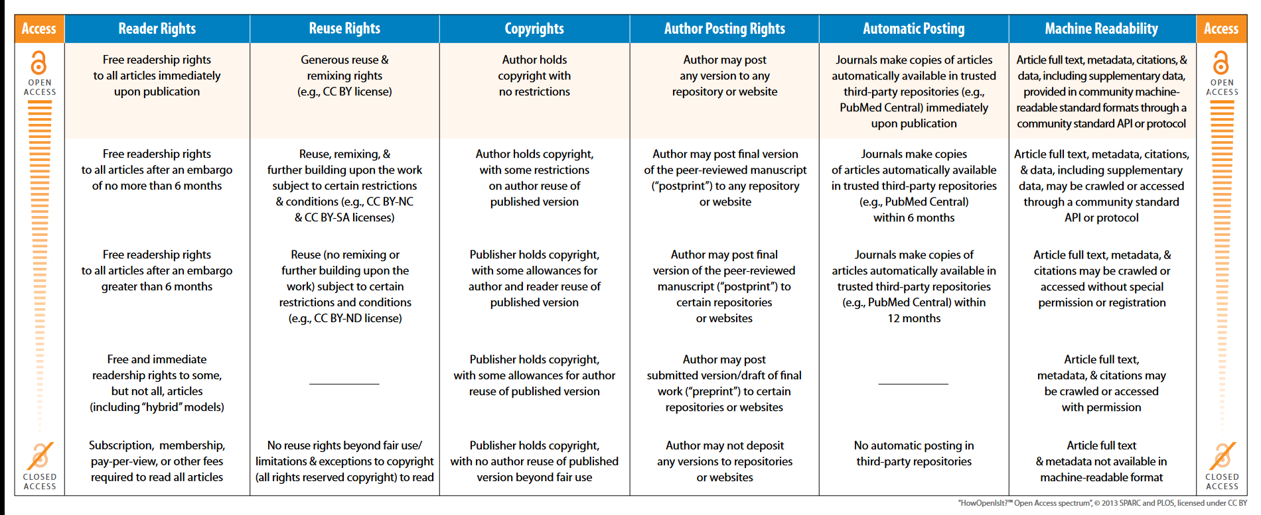
“Open Access” is an Umbrella Concept

Slide 51
Open Access Types
Green OA, Also known as self-archiving – The sharing through self-archiving a copy of an article through a digital repository or pre-print service like arXiv.
Gold OA – Research outputs which are published to be open, forever to be freely read, and usually licensed with an open license.
Diamond OA – Gold OA except explicitly conveys there is no Article Processing Charge (APC) to publish.

Slide 53
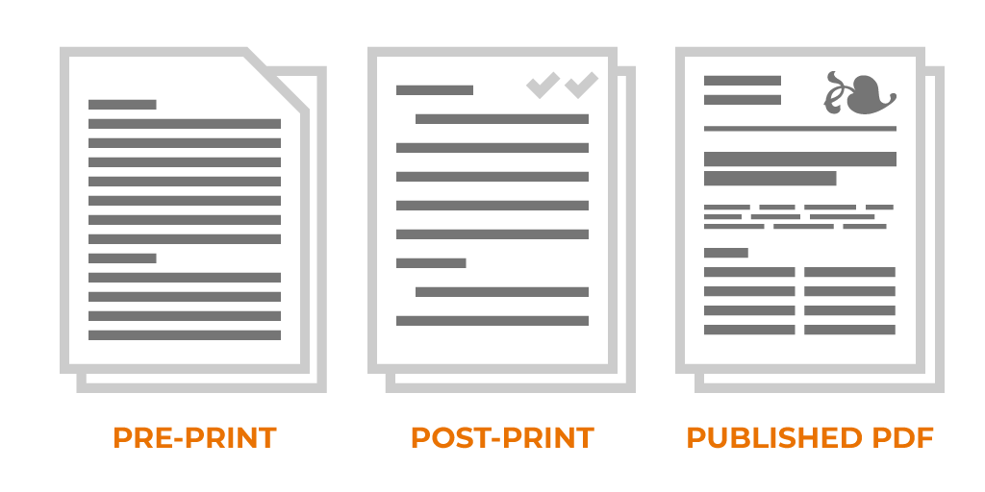
Green Open Access/
Self-Archiving
Submitted Manuscript
Repository
Pre-print servers
Social Networks
Personal Website
Accepted Manuscript
Repository
Personal Website
Social Networks (Maybe)
Embargo
Version of Record
Email to Colleague

Slide 54
Green Open Access/
Self-Archiving
Almost every large journal publisher has a self-archiving policy explaining what authors can do with their:
Preprint/Submitted Manuscript
Accepted Manuscript
Version of Record

Slide 55
Publishing & Your ETDR
Elsevier Policies—Article sharing
Preprint/Submitted Manuscript
Author's Accepted manuscript
This is the author's own write-up of research results and analysis that has not been peer reviewed, nor had any other value added to it by a publisher (such as formatting, copy-editing, technical enhancements and the like).
Authors can share their preprint anywhere at any time
An accepted manuscript is the manuscript of an article that has been accepted for publication and which typically includes author-incorporated changes suggested during submission, peer review and editor-author communications. They do not include other publisher value-added contributions such as copy-editing, formatting, technical enhancements and, if relevant, pagination.
After the embargo period

Slide 56
What about Evaluation?
The global research architecture characterized and structured by an unlimited quest for rankings
Metrics like the Journal Impact Factor (JIF) and journal acceptance rates create and drive artificial scarcity
Creates avenues for competition among researchers, departments, universities, and even whole countries
Hiring, Tenure, Promotion, Grants, and much, much more
Explore Metrics Through the Metrics Toolkit
https://www.metrics-toolkit.org/
Notes:
An international problem, not just national or local to K-State
Scholarly communications cycle that applies to many disciplines, especially in the STEM fields:
Governments provide most of the funding for research
Researchers publish their findings without the expectation of compensation in the interest of advancing human knowledge
Through the process of peer review, researchers review each others work for free
Once published, those that contribute to research (from taxpayers to the institutions that support the research itself) have to pay again to access the findings. Though research is produced as a public good, it isn’t available to the public who paid for it (SPARC)

Slide 57
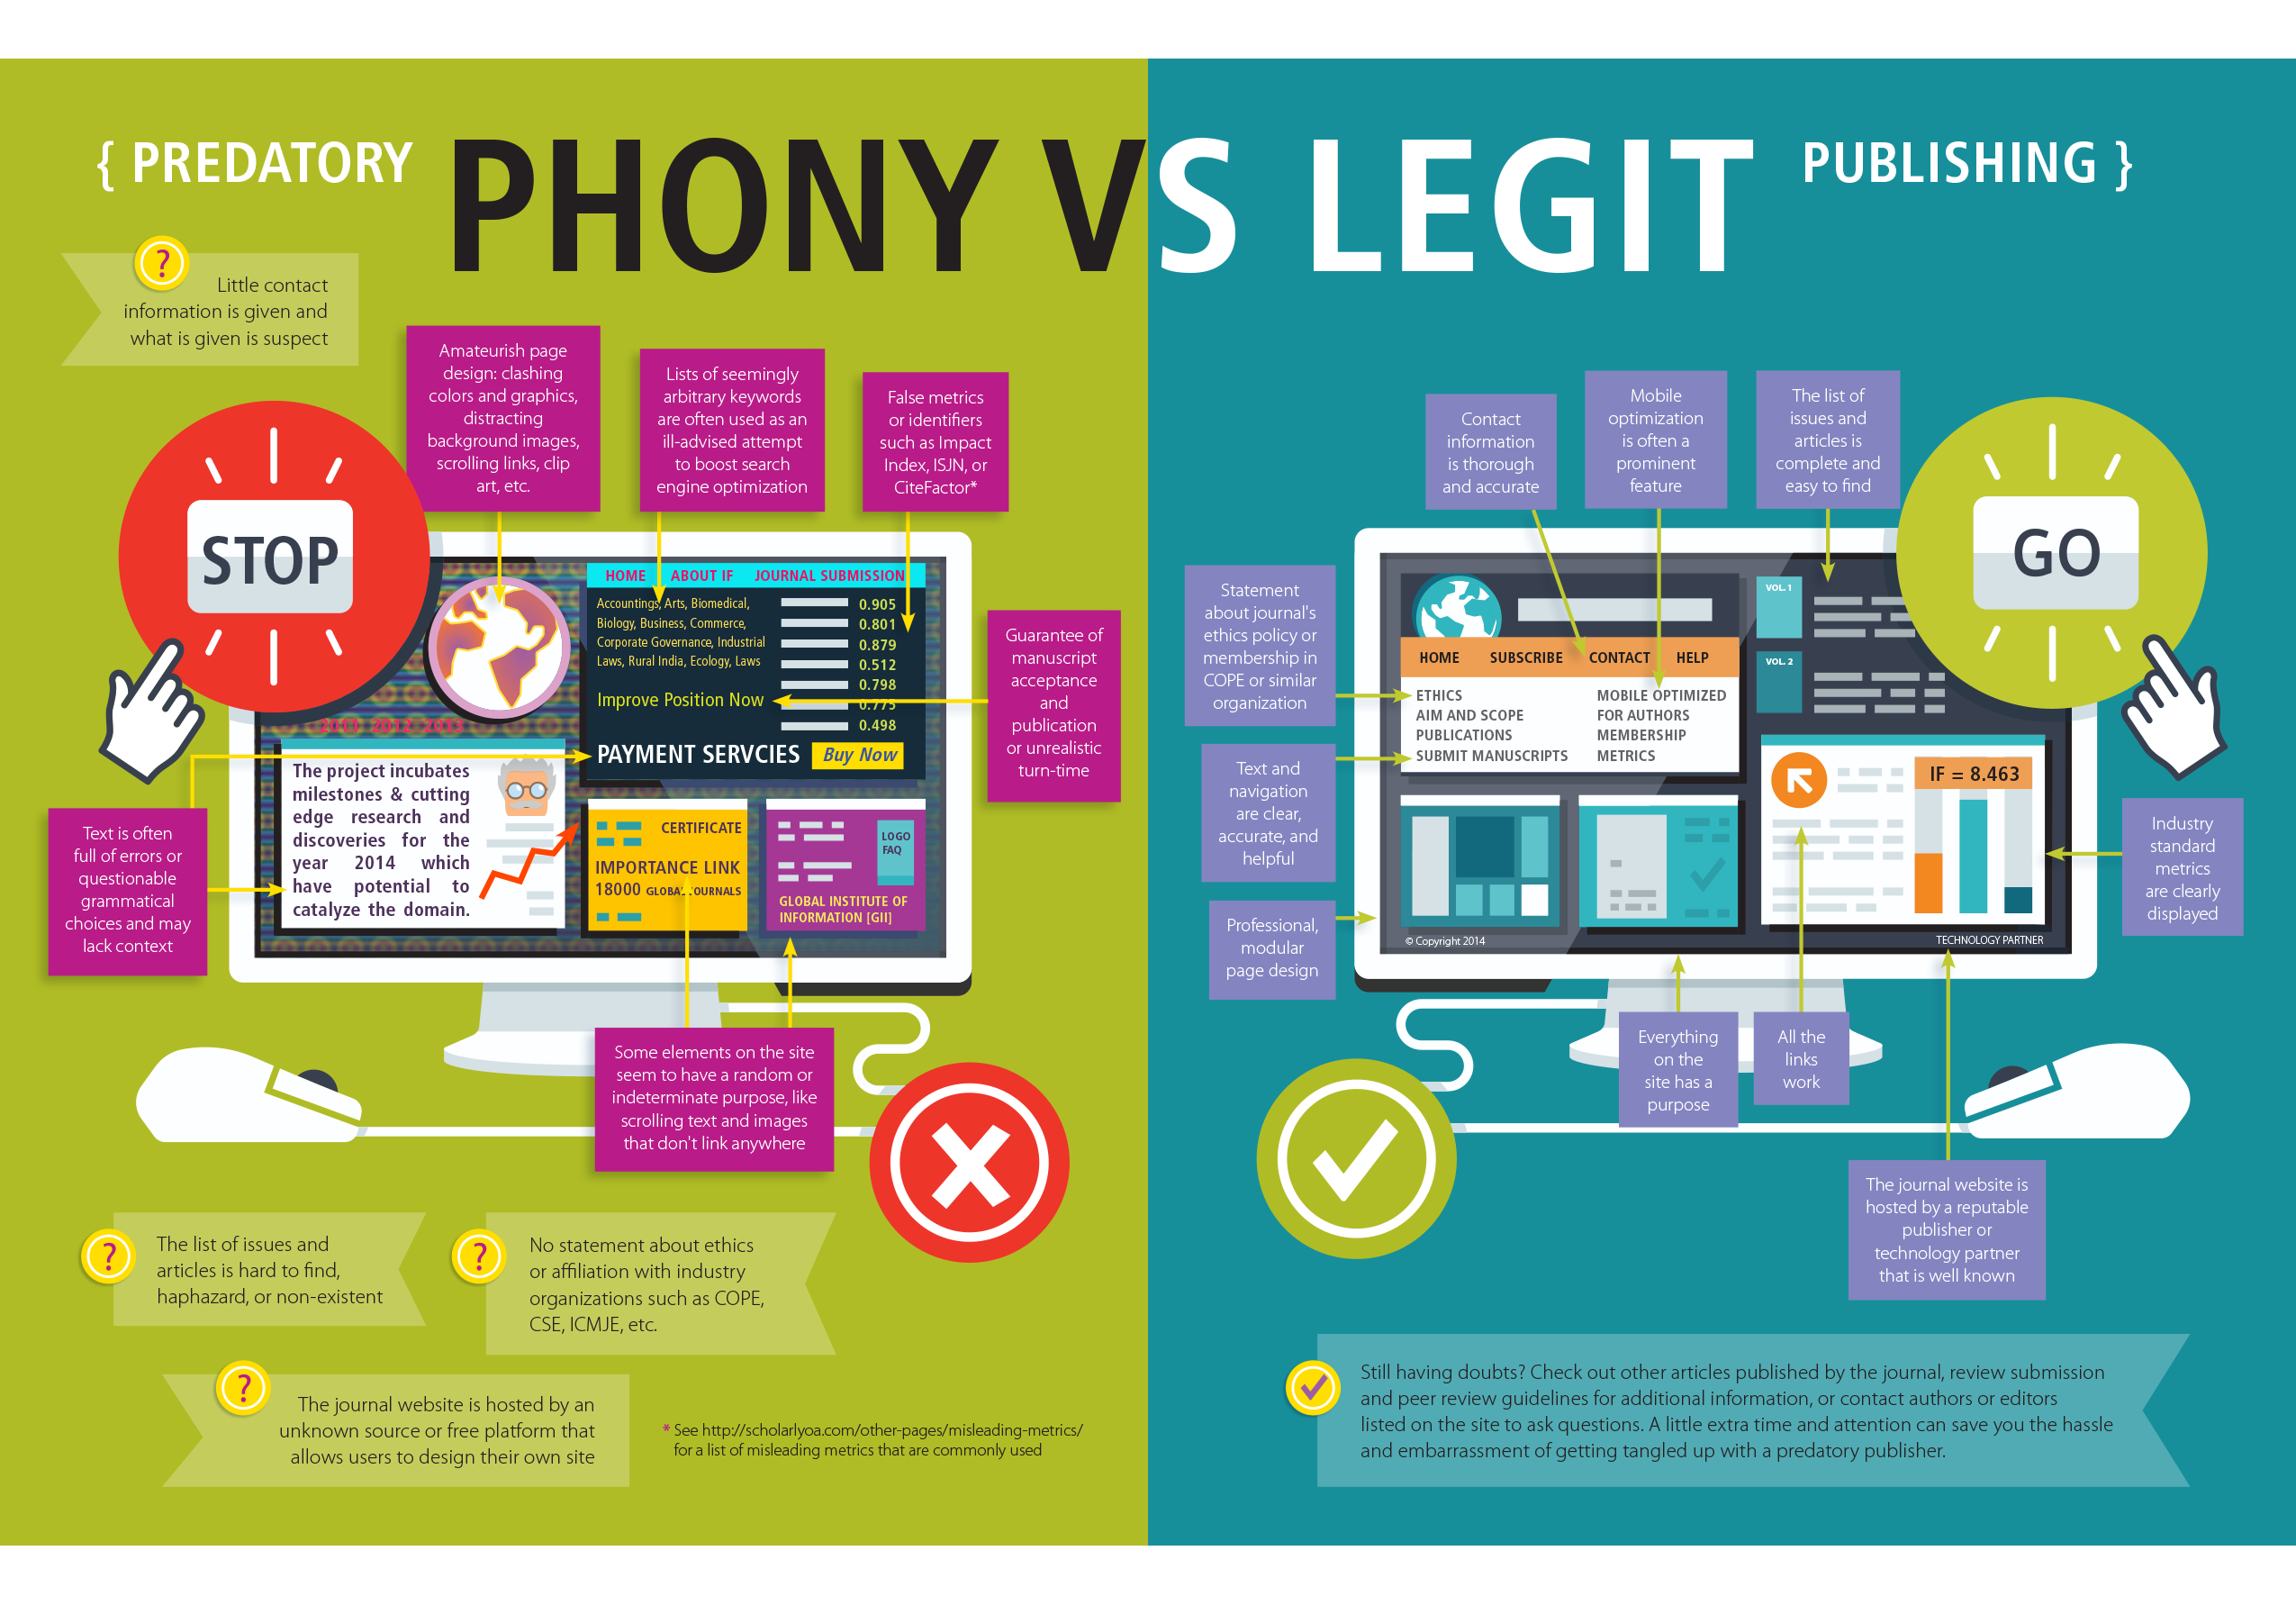
Evaluating Scholarly Journals infographic from FrontMatter by Allen Press / CC BY ND NC 3.0

Slide 58
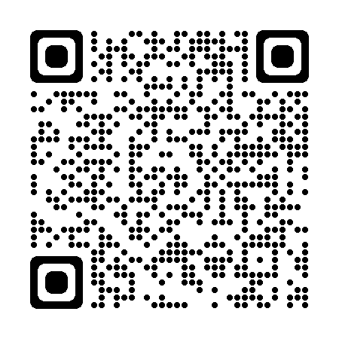
Predatory Publishing
What makes a journal good or acceptable?
Impact Factor?
Indexed?
Just Remember,
Think
Check
Submit
Attr: Drew Tarvin

Slide 59
Copyright Services
https://www.k-state.edu/copyright/

